Slide 1
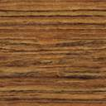
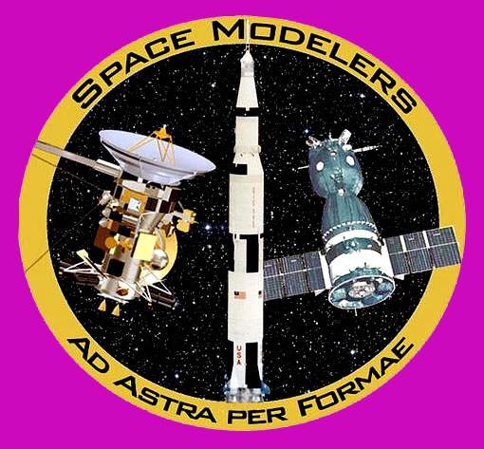
Welcome!
Fellow Space Modelers!
to IPMS 2015

Slide 2

With Special Thanks…
to Mike M.
and Sven

Slide 3
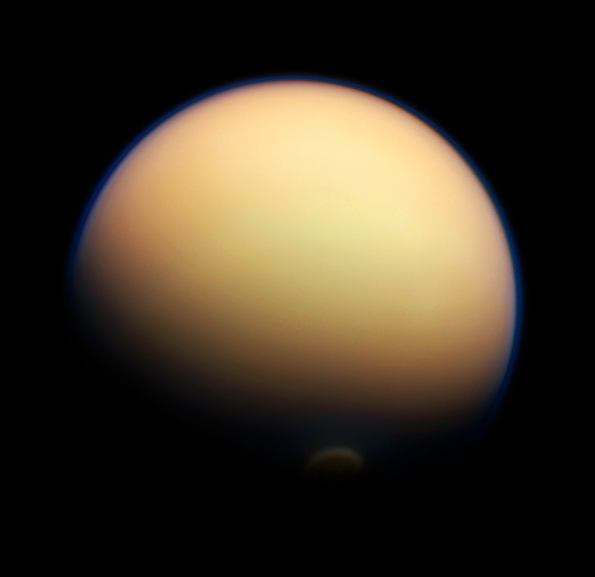



Cassini-Huygens
Mission to Titan

Slide 4
The Objective: Titan
aka “Saturn VI”
Largest moon of Saturn
Only natural satellite known to have a dense atmosphere
50% larger and 80% more massive than Earth’s moon
2nd largest moon in the solar system, after Ganymede
Only object other than Earth where clear evidence of stable bodies of surface liquid has been found

Slide 5
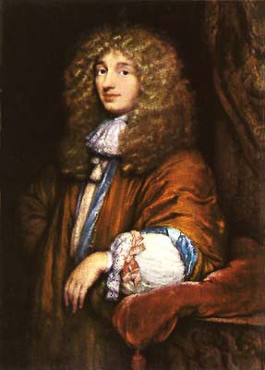
Titan
Titan was discovered on March 25, 1655 (exactly 302 years before I was born) by the Dutch astronomer Christiaan Huygens using a telescope he and his brother built

Slide 6
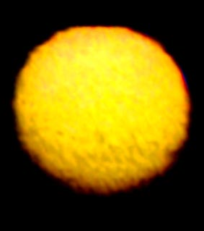
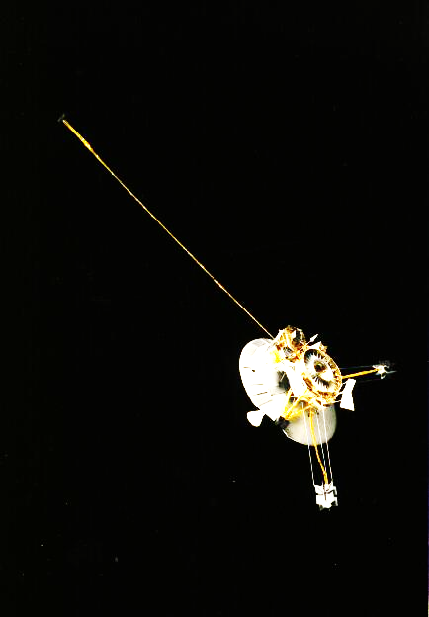
Exploration of Titan
First spacecraft to image Titan was Pioneer 11 on September 3, 1979 from a range of 3.6 million km.

Slide 7
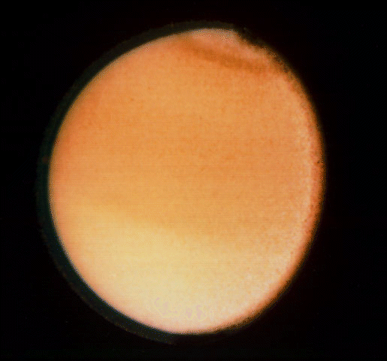
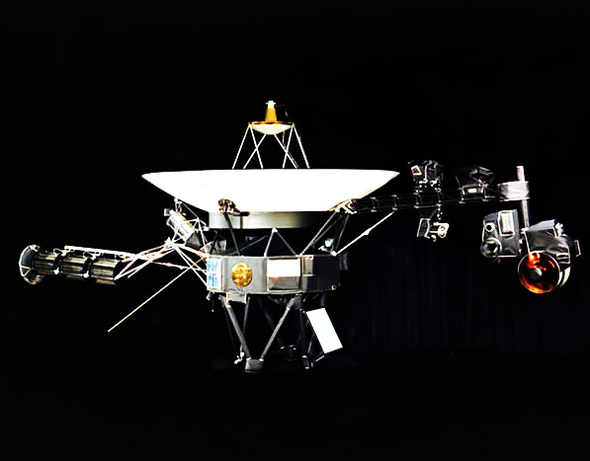
Exploration of Titan
Voyager 1 flew by Titan at a distance of 2,485 miles (4,000 km) on November 12, 1980.

Slide 8
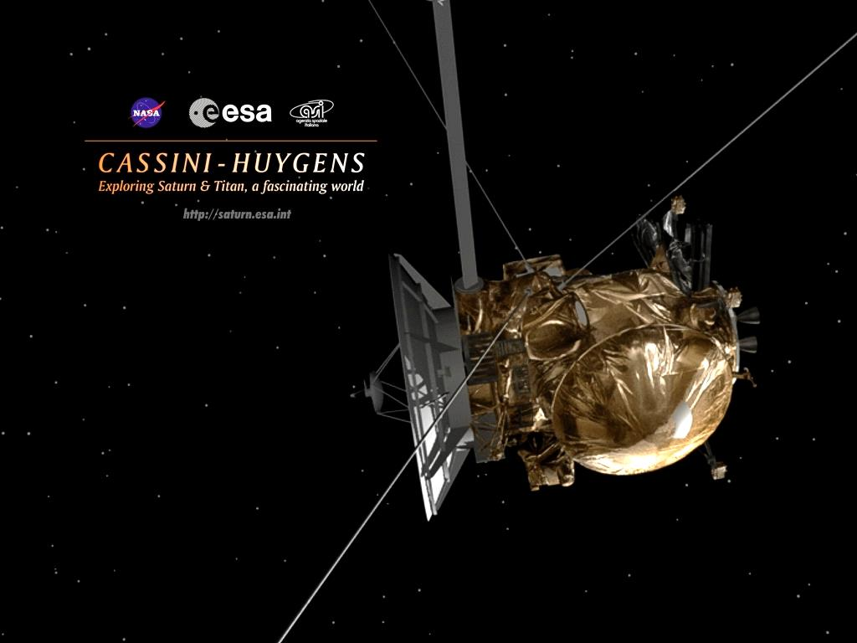
…and then came Cassini-Huygens

Slide 9
Cassini Facts
Built for NASA by JPL, and the Italian Space Agency (ASI)
Joint NASA/ESA project, involved 16 European countries + the USA
Including the orbiter and probe, it is the largest and most complex unmanned interplanetary spacecraft ever built
The orbiter has a mass of 2,150 kg (4,740 lb.), the probe 350 kg (770 lb.)
The Cassini spacecraft is 6.8 meters (22 ft.) high and 4 meters (13 ft.) wide

Slide 10
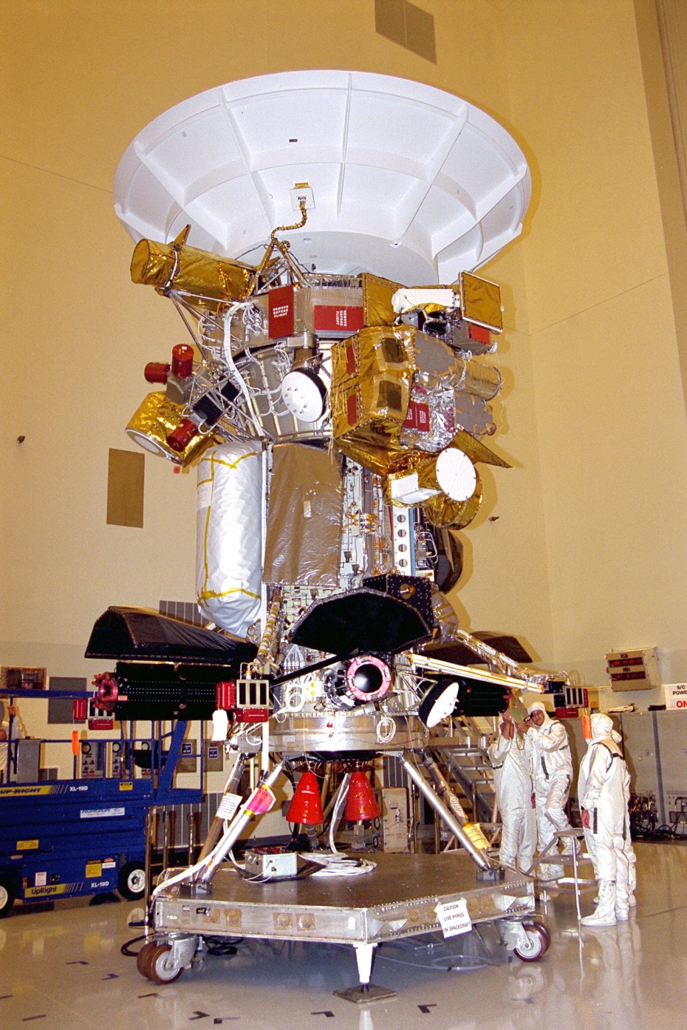
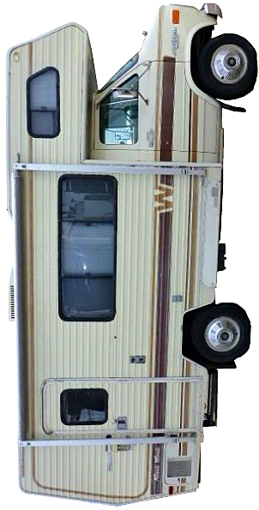
Cassini is BIG
Cassini
Winnebago Chieftain
Wow, that’s BIG!

Slide 11
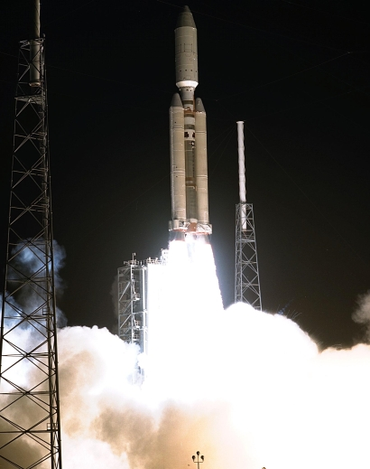
Cassini-Huygens Launch
The spacecraft was launched from Cape Canaveral LC 40 atop a Titan IV-B/Centaur launch vehicle on 15 October 1997.

Slide 12
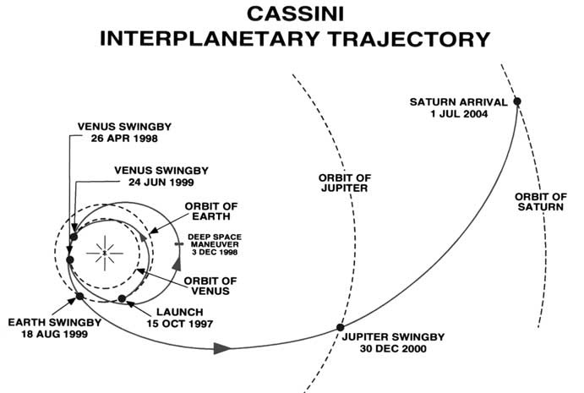
VVEJGA Trajectory
Venus-Venus-Earth-Jupiter Gravity Assist

Slide 13
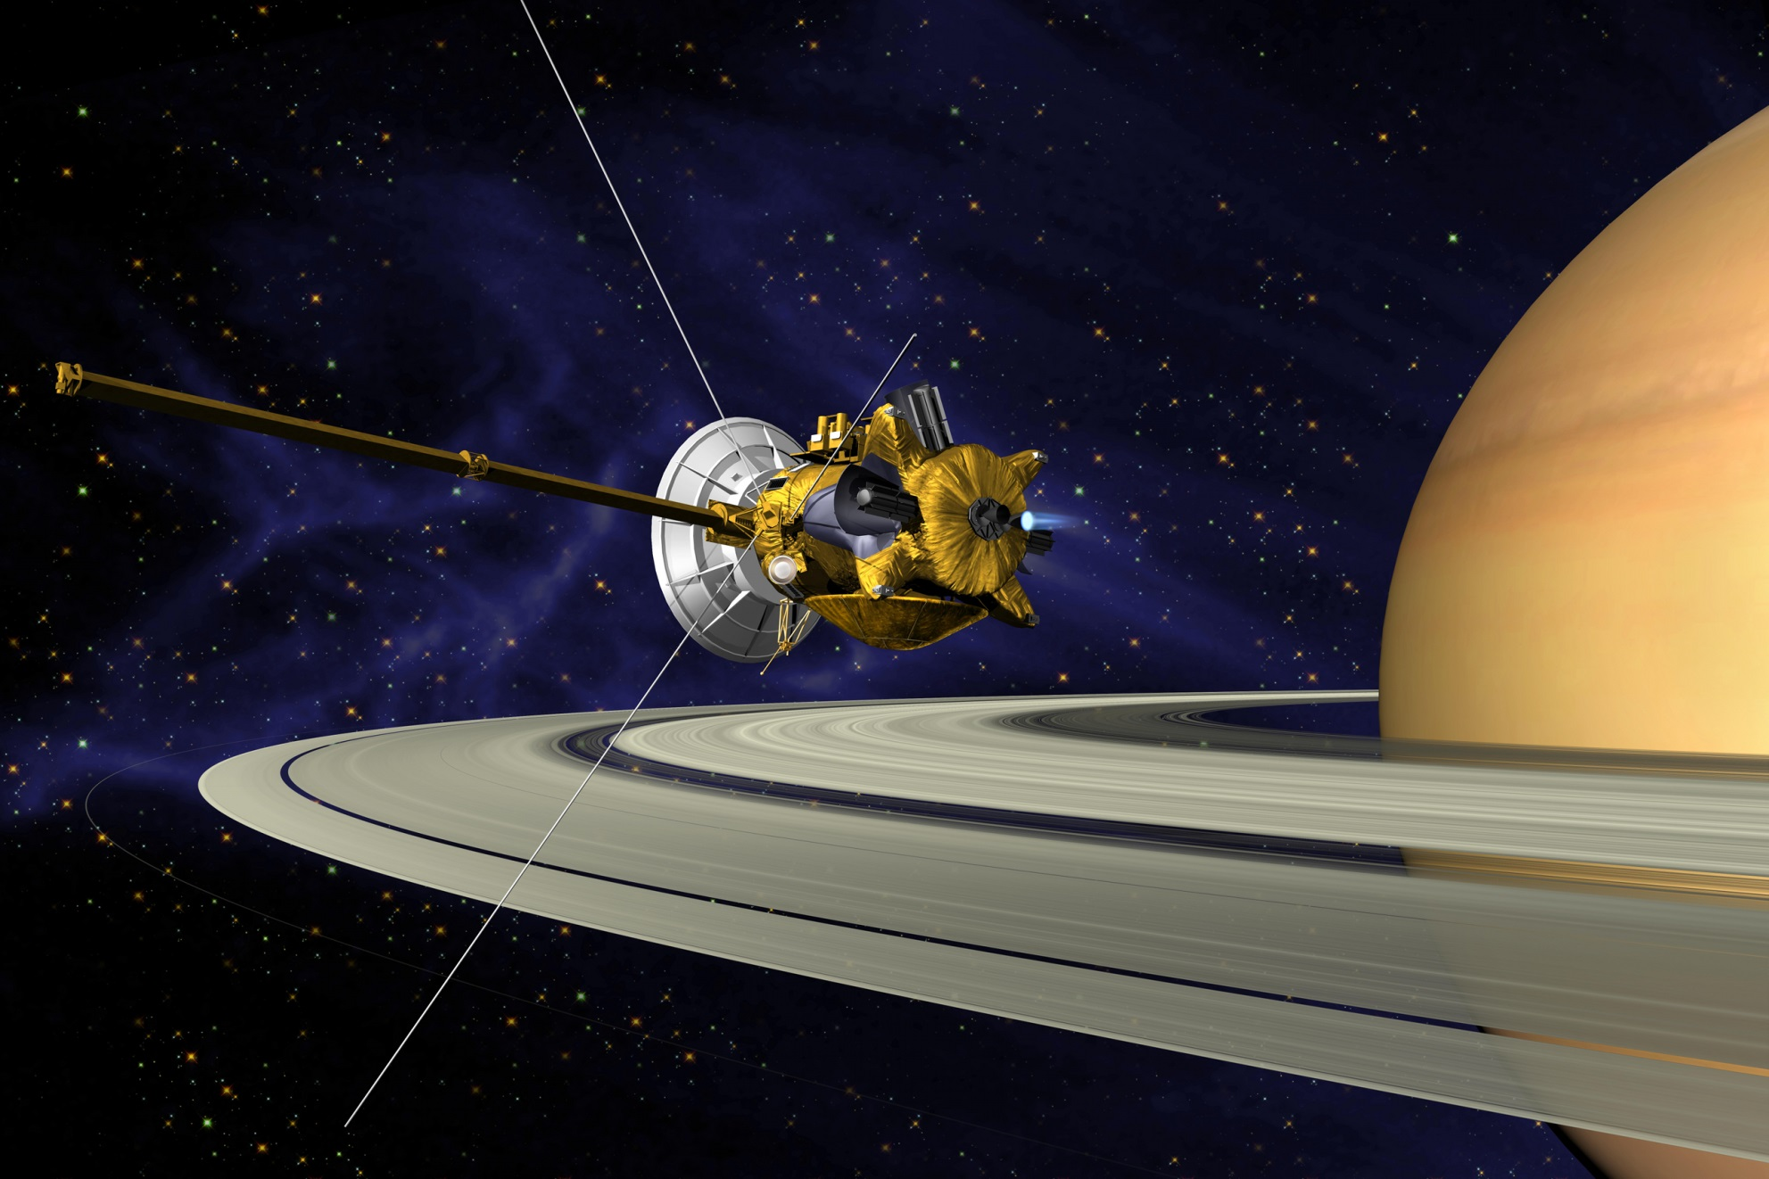
Saturn Orbital Insertion
July 1, 2004, and still going strong!

Slide 14
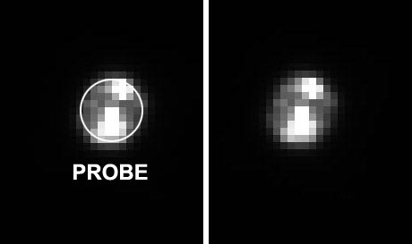
Huygens Probe, Center Stage
The Huygens probe separated from Cassini on Christmas day, 2004
Originally scheduled for the first Titan encounter by Cassini, separation occurred on the 2nd Titan encounter to correct for a signaling error between the two spacecraft
Huygens probe separation
photo taken by camera
on Cassini

Slide 15
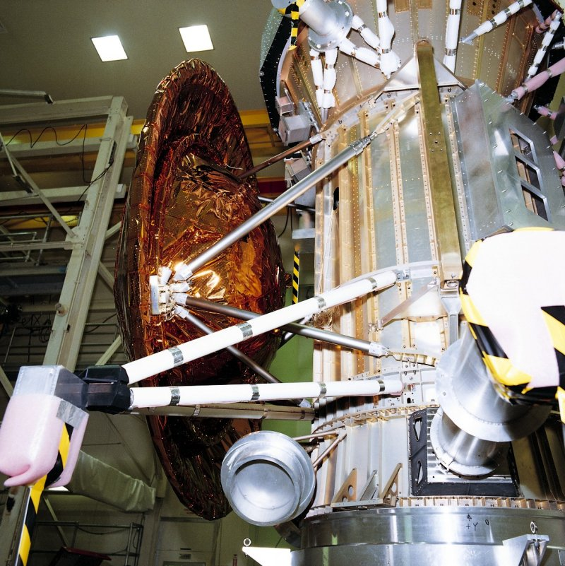
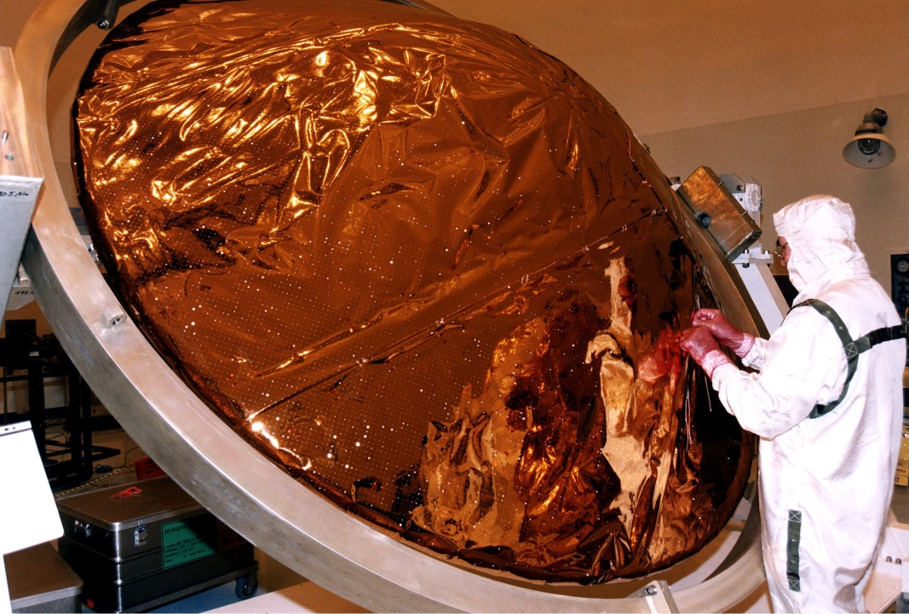
Huygens’ Heat Shield
As with all interplanetary probes entering an atmosphere, Huygens needed an aeroshell (heat shield)

Slide 16
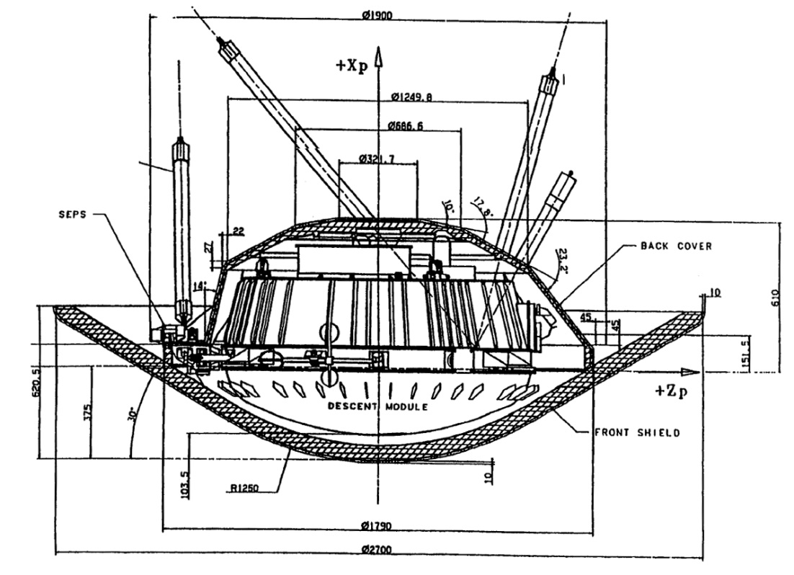
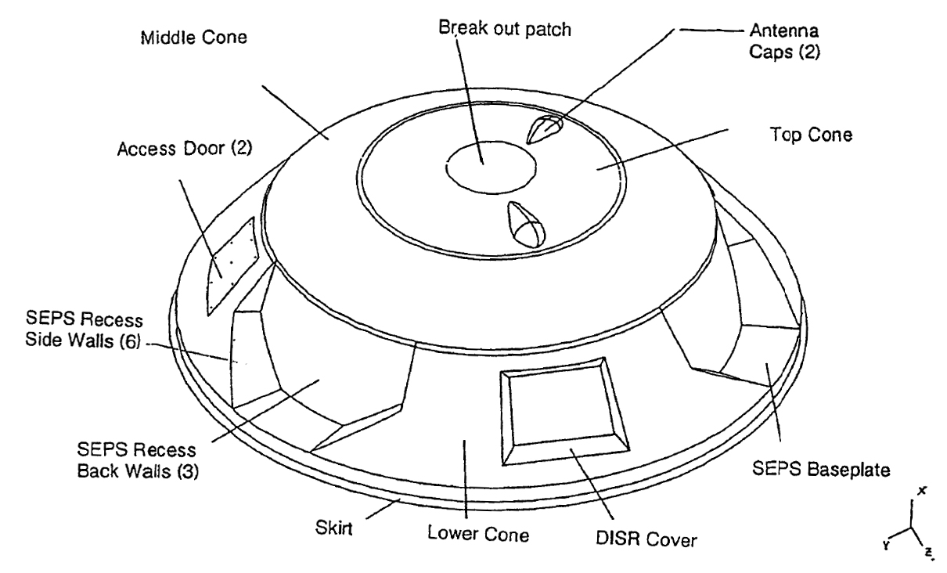
Huygens’ Heat Shield

Slide 17
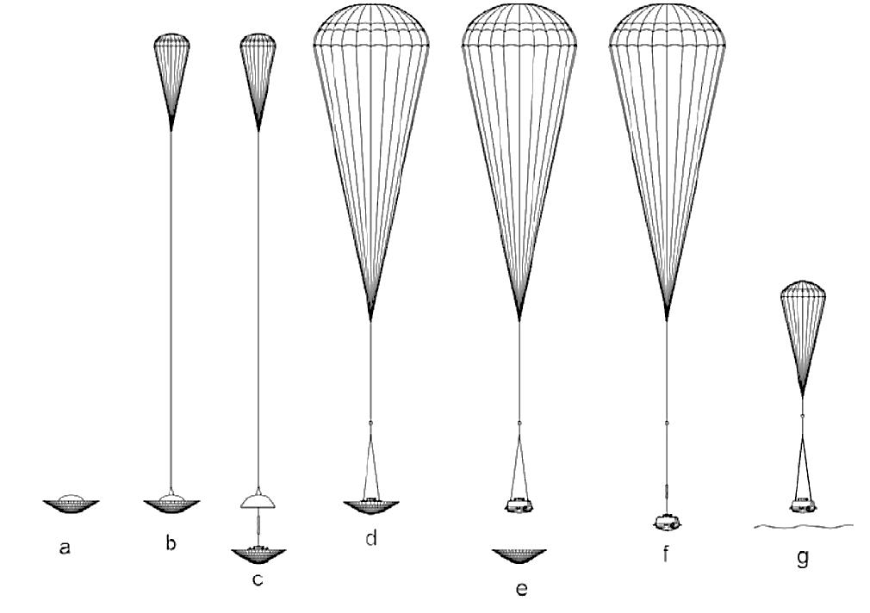
Entry-Descent-Landing
Huygens’ primary mission = atmospheric science
Secondary mission = surface science
So, it was designed to descend slowly

Slide 18
Entry-Descent-Landing (Cont’d)
Huygens EDL Timeline: January 14, 2005
Time (UTC) | Time (EST) | Time after entry | Altitude | Speed | Event
09:06 | 05:06 | 0 | 1270 km | Mach 1.48 | Huygens enters the atmosphere of Titan
09:09 | 05:09 | 3' |  |  | Huygens feels maximum deceleration
09:10 | 05:10 | 4' | 164 km | 400 m/s | Deploy pilot chute
09:10 | 05:10 | 4' |  |  | Release aft cover
09:10 | 05:10 | 4' |  | Mach 1.5 | Deploy main parachute
09:11 | 05:11 | 5' |  |  | Begin transmission to Cassini orbiter
09:11 | 05:11 | 5' |  | Mach 0.5 | Release front shield; transmitters switch to high power mode; instruments configured for descent and measurements commence
09:25 | 05:25 | 19' | 125 km |  | Main parachute separates; deploy stabilizing drogue chute
09:42 | 05:42 | 36' | 60 km |  | Surface proximity sensor (landing radar) activated
09:49 | 05:49 | 43' |  |  | Possible icing effects on probe
09:50 | 05:50 | 48' |  |  | Gas Chromatograph Mass Spectrometer begins sampling atmosphere
11:23 | 06:23 | 2" 17" |  |  | Turn on descent imager lamp
11:24 | 06:26 | 2" 18" | 0 | 0 | Huygens impact with surface of Titan
This is an unofficial timeline. We have been unable to
find an official timeline for the Huygens EDL

Slide 19
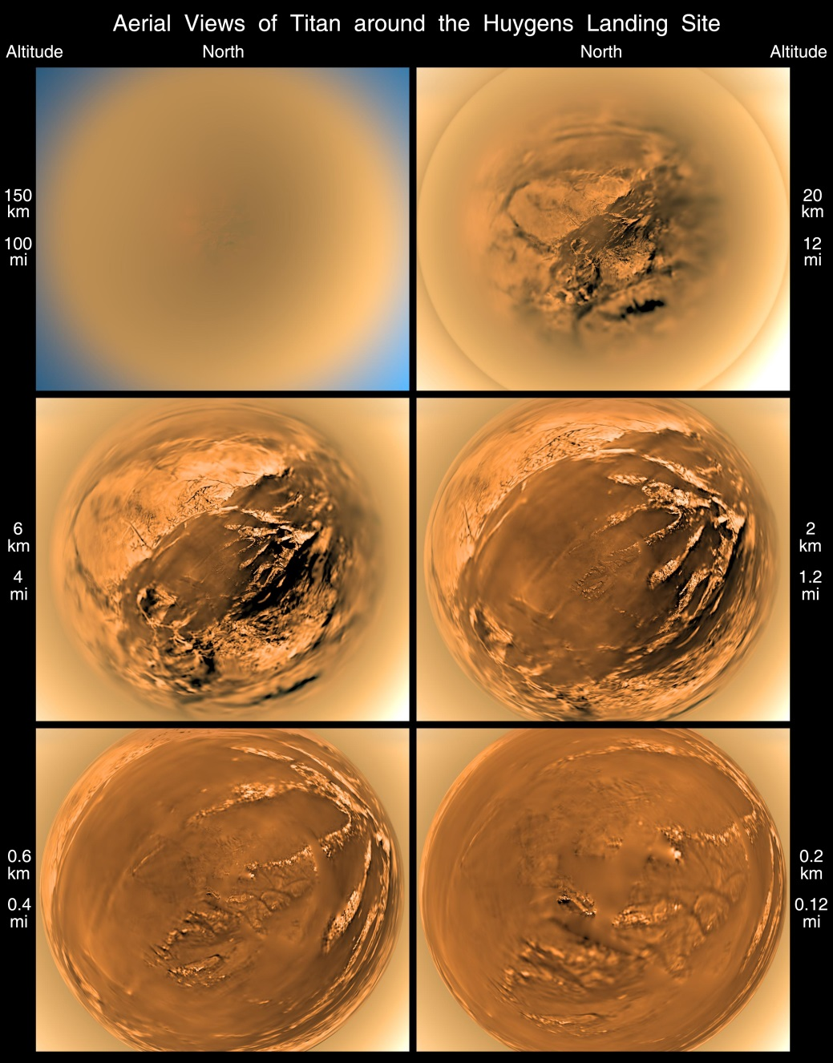
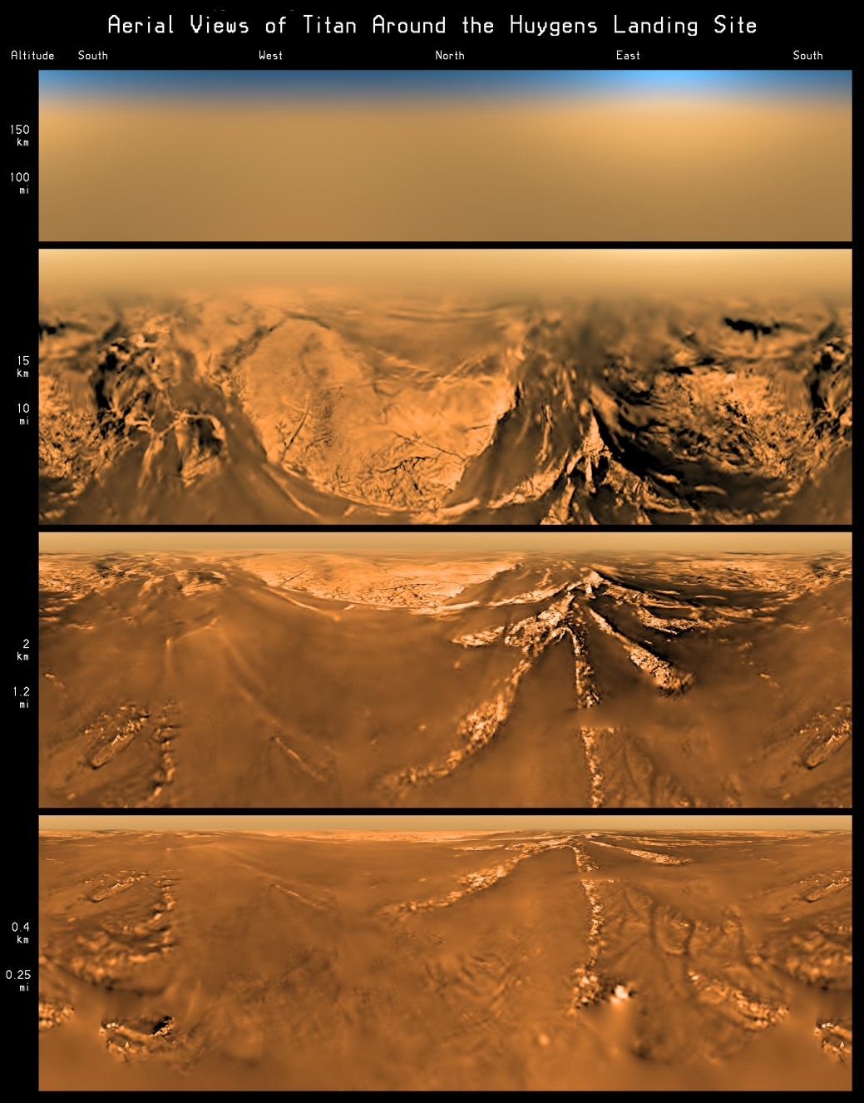
…and, this is what we saw!

Slide 20
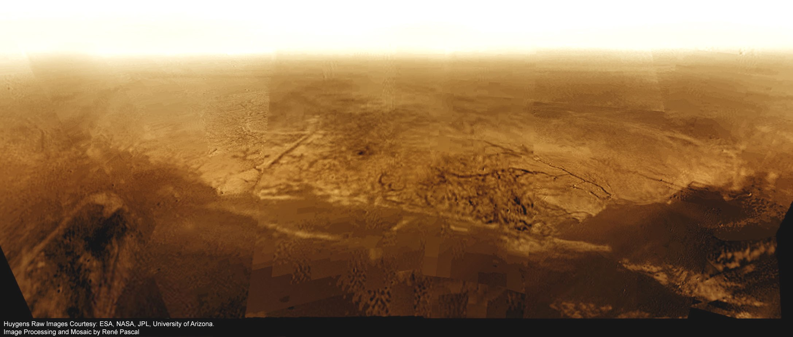
Behold Adiri

Slide 21
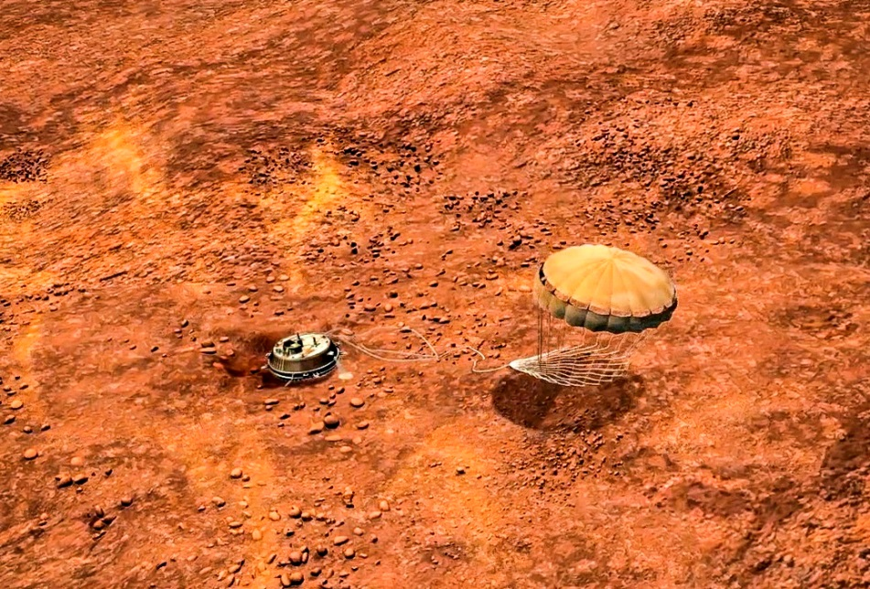
Touchdown!

Slide 22
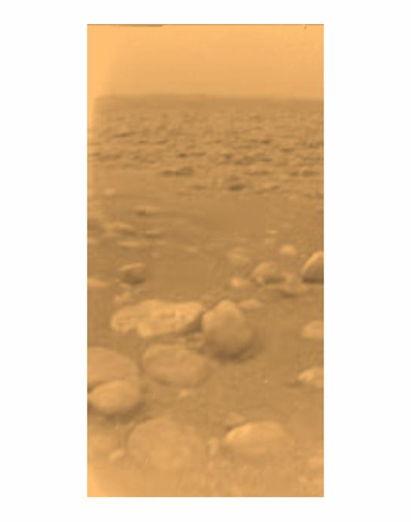
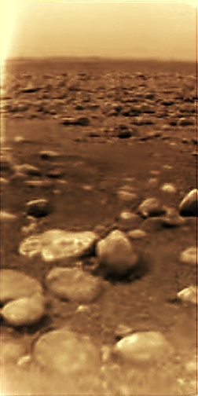
First DISR Images From Titan’s Surface
Raw Image
Probable true color

Slide 23
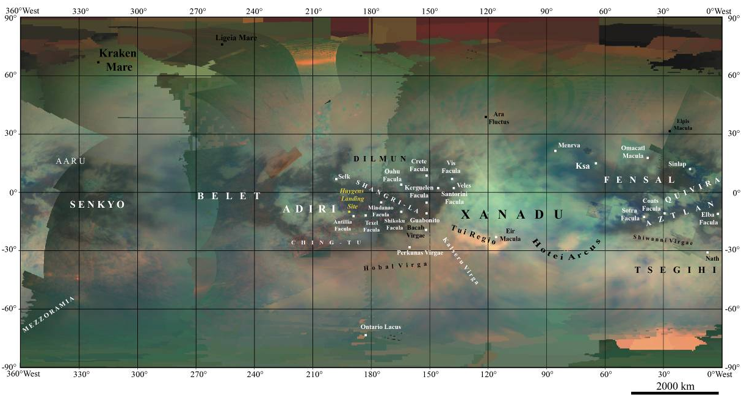
Our new view of Titan
Huygens landing site, Eastern Adiri 10°12′S 192°24′W﻿

Slide 24
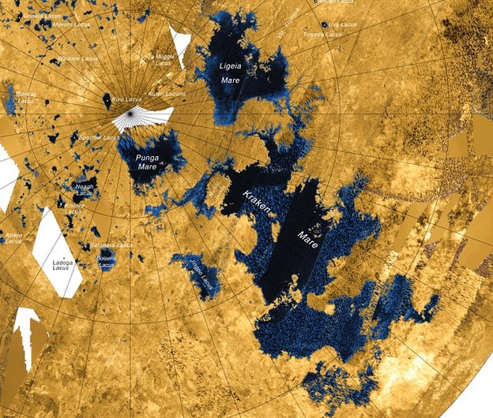
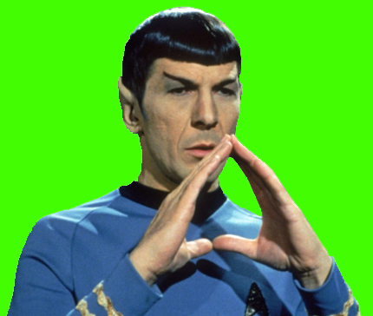
Titan is a wet world
Ligeia Mare
Small Lakes Region
Punga Mare
Kraken Mare
Fascinating!

Slide 25
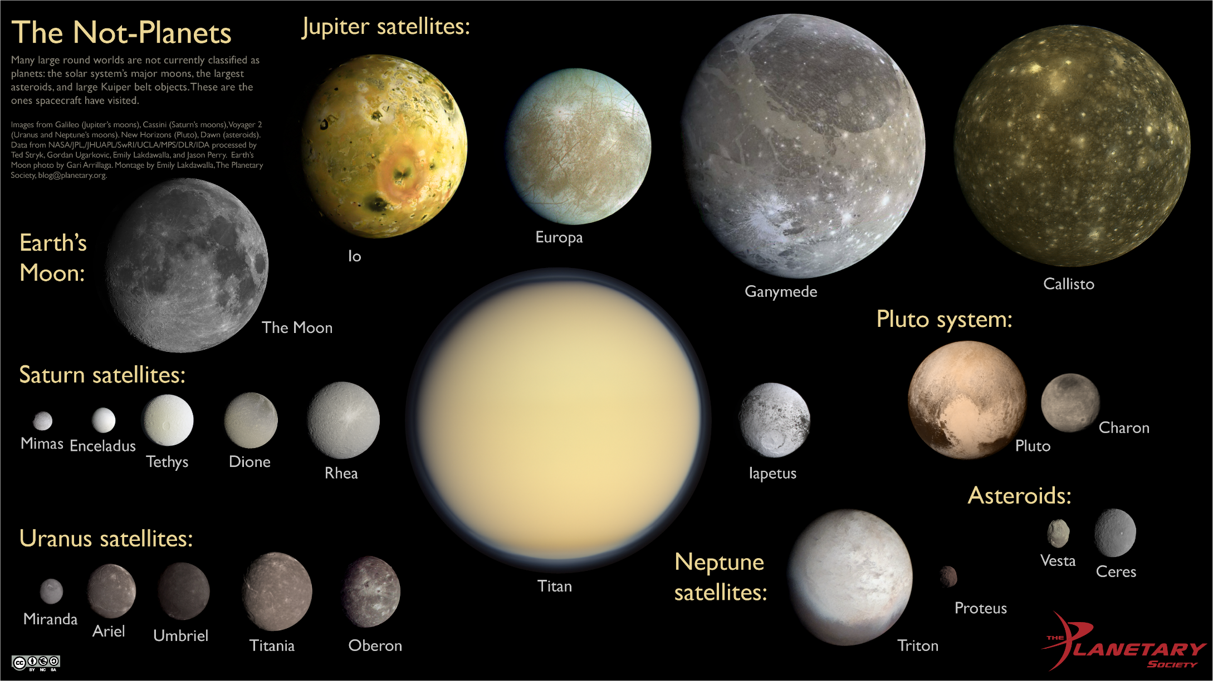
Titan in perspective….

Slide 26
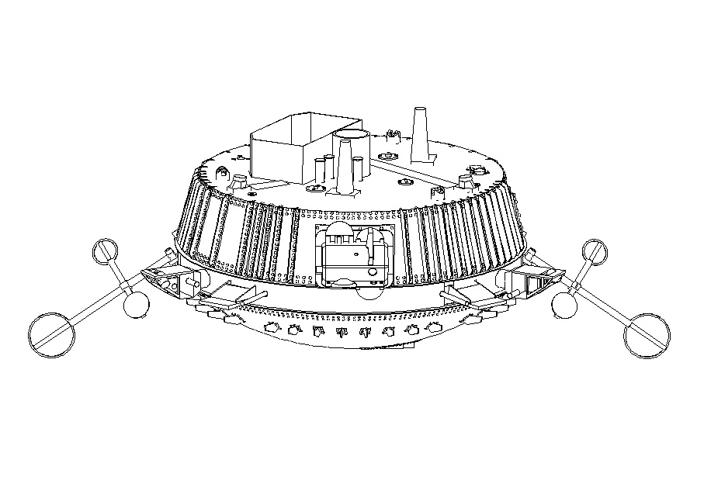
The Spacecraft

Slide 27
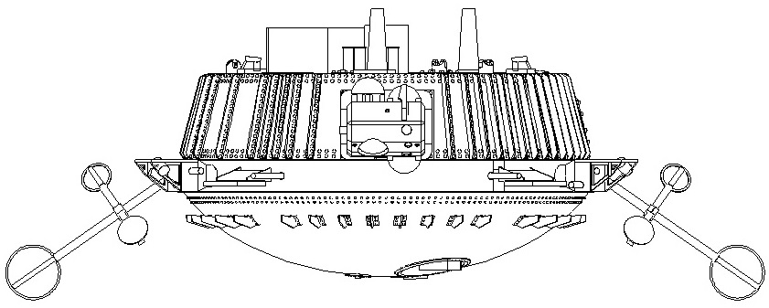
Descent Module
Diameter: 1.3 m/4.26 feet
Height: 63.1 cm/24.8 inches
Weight: 219.8 kg/484.5 lbs.

Slide 28
Huygens Experiments
Huygens Atmospheric Structure Instrument (HASI)
  This instrument contains a suite of sensors that measured the physical and electrical properties of Titan's atmosphere.
Doppler Wind Experiment (DWE)
  This instrument was used to measure the wind speed in Titan's atmosphere by measuring the Doppler shift in the carrier signal. Failure of ground controllers to turn on the receiver in the Cassini orbiter caused the loss of this data.
Descent Imager/Spectral Radiometer (DISR)
  Complex camera and spectrometer system used for visual and spectral analysis of Titan and its’ atmosphere

Slide 29
Huygens Experiments
Gas Chromatograph Mass Spectrometer (GC/MS)
  This instrument is a versatile gas chemical analyzer that was designed to identify and measure chemicals in Titan's atmosphere.
Aerosol Collector and Pyrolyser (ACP)
  The ACP experiment drew in aerosol particles from the atmosphere through filters, then heated the trapped samples in ovens (using the process of pyrolysis) to vaporize volatiles and decompose the complex organic materials.
Surface Science Package (SSP)
  The SSP contained a number of sensors designed to determine the physical properties of Titan's surface at the point of impact, whether the surface was solid or liquid.

Slide 30
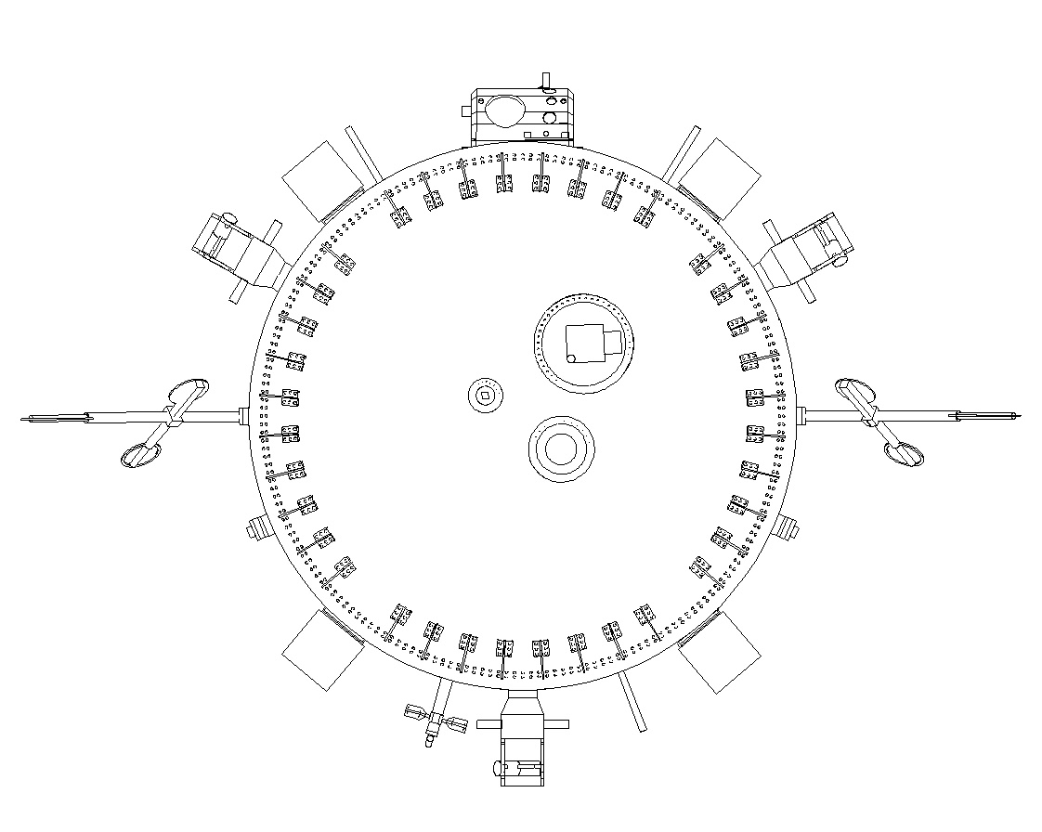
Huygens Experiments
DISR Head
ACP
Aperture
SSP
Aperture
HASI Boom
HASI Boom
GC/MS
Aperture
HASI Stub
View from bottom of spacecraft looking up, -X axis

Slide 31
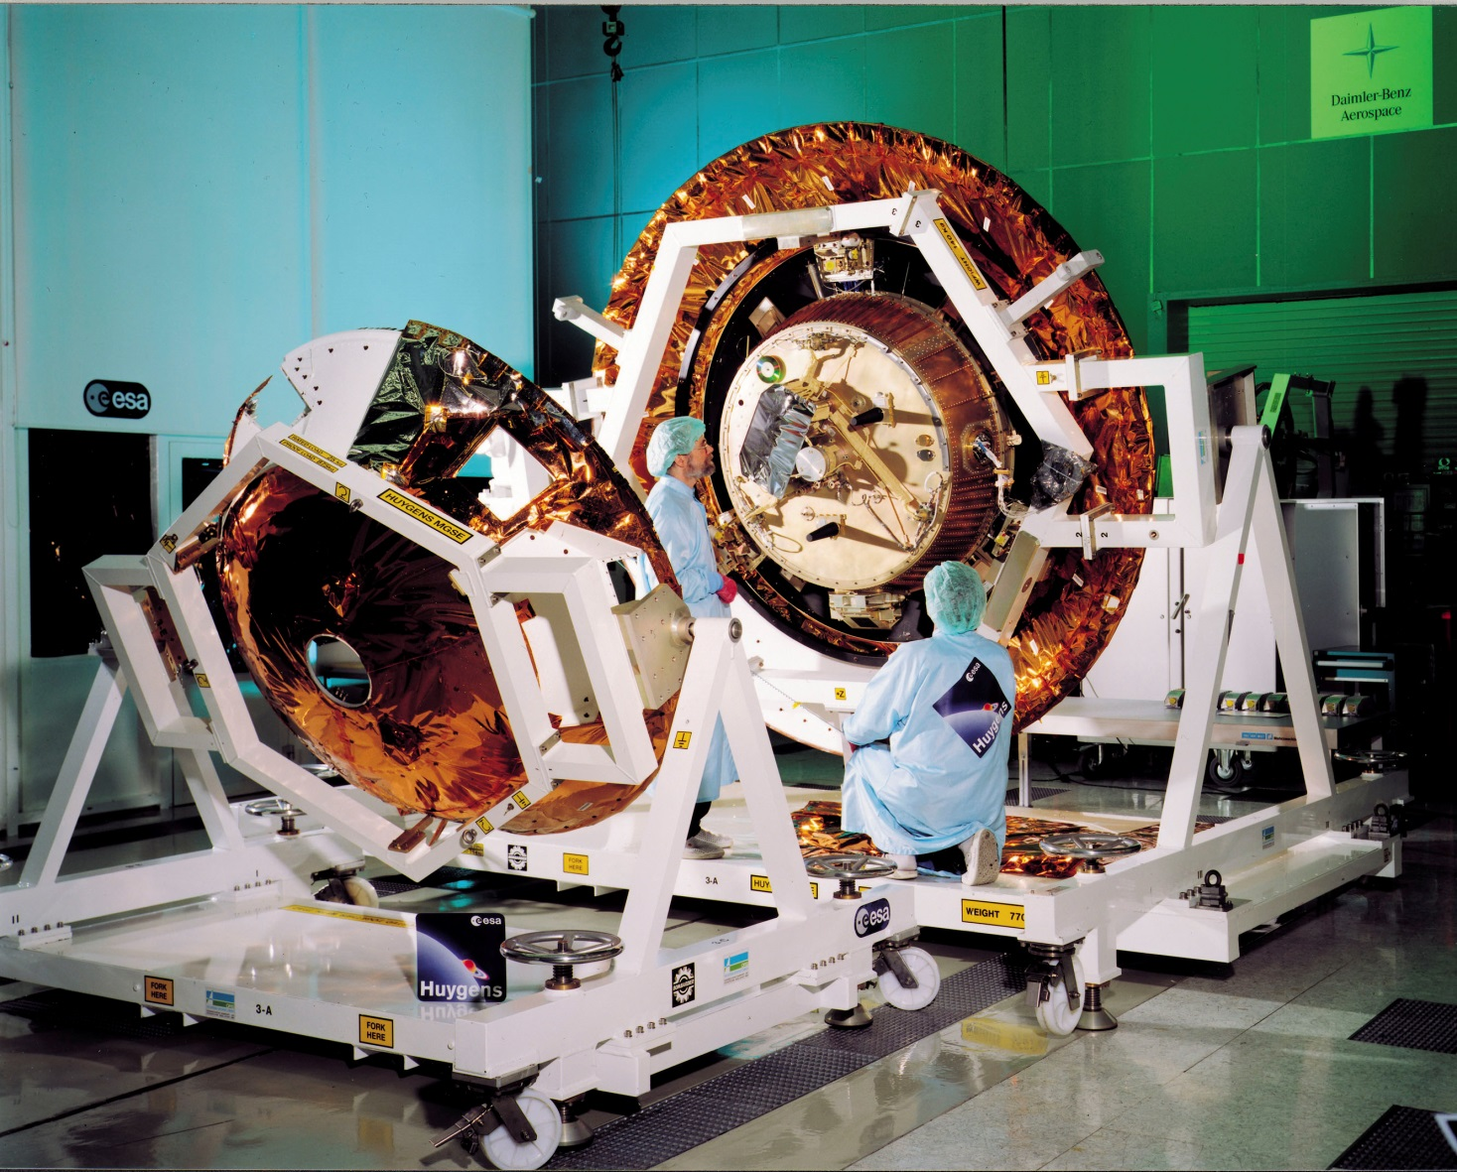
The Flight Vehicle
The ONLY photos we could obtain of the actual flight vehicle looked something like this:

Slide 32
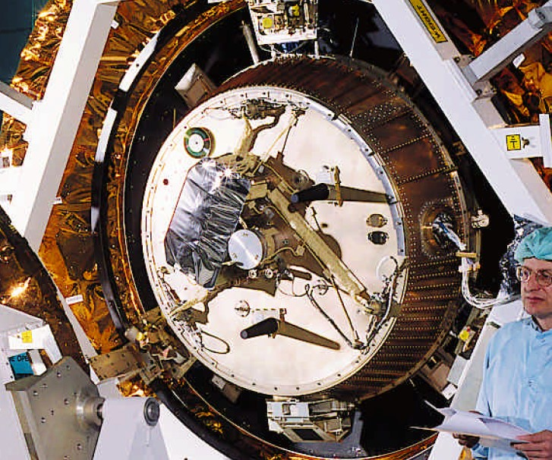
The Flight Vehicle

Slide 33
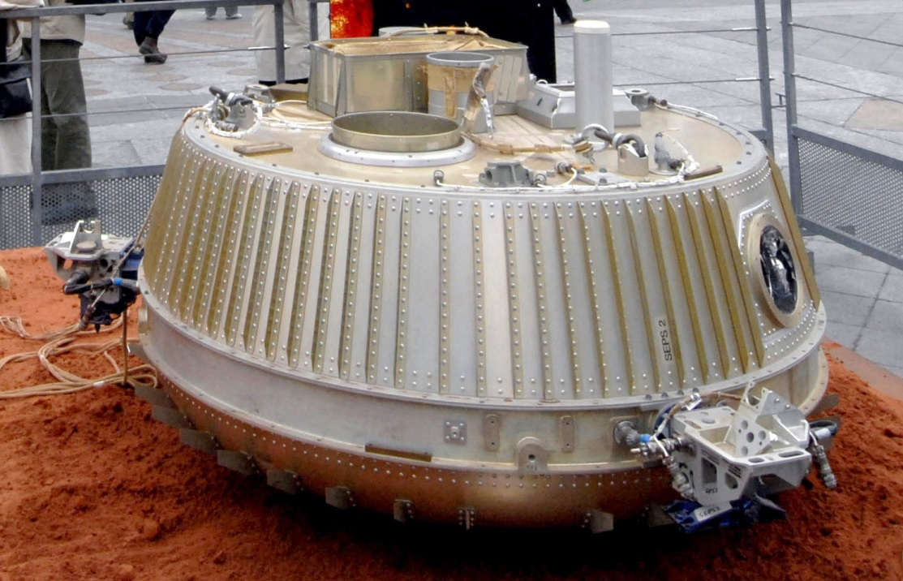
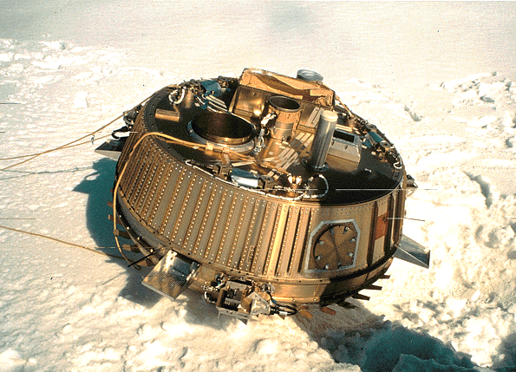
Mockups

Slide 34
After months of studying photos of the flight vehicle, the mockups, museum exhibits, scientific papers, and technical documents, we feel pretty confident with what we came up with

Slide 35
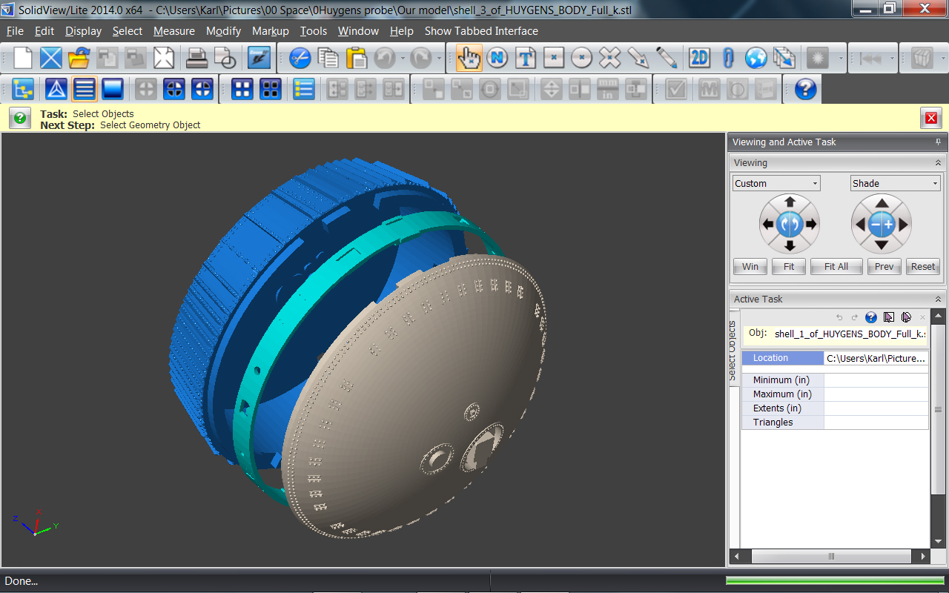

Slide 36
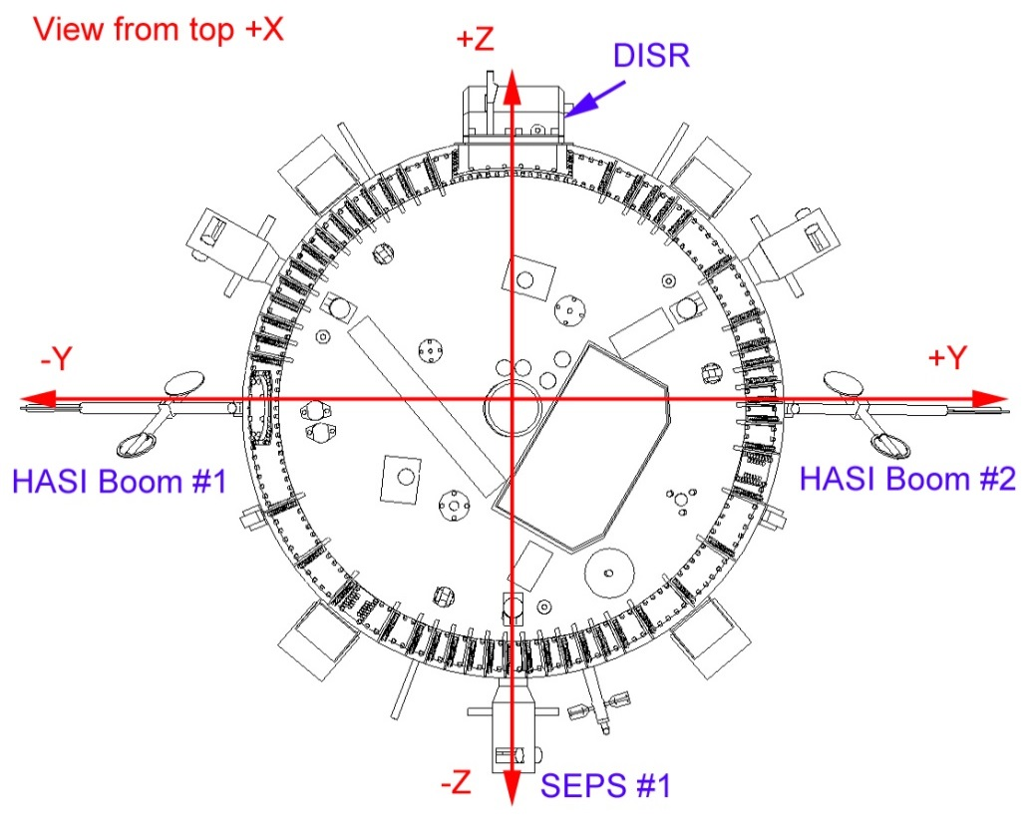
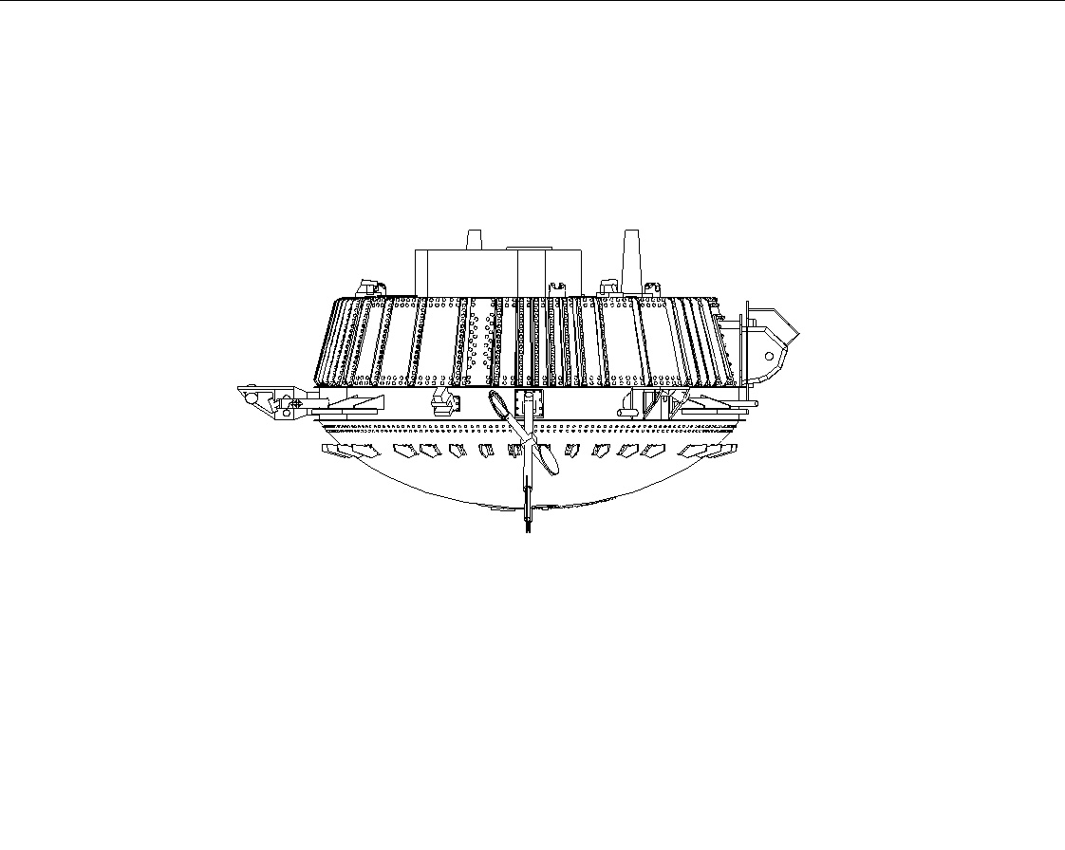
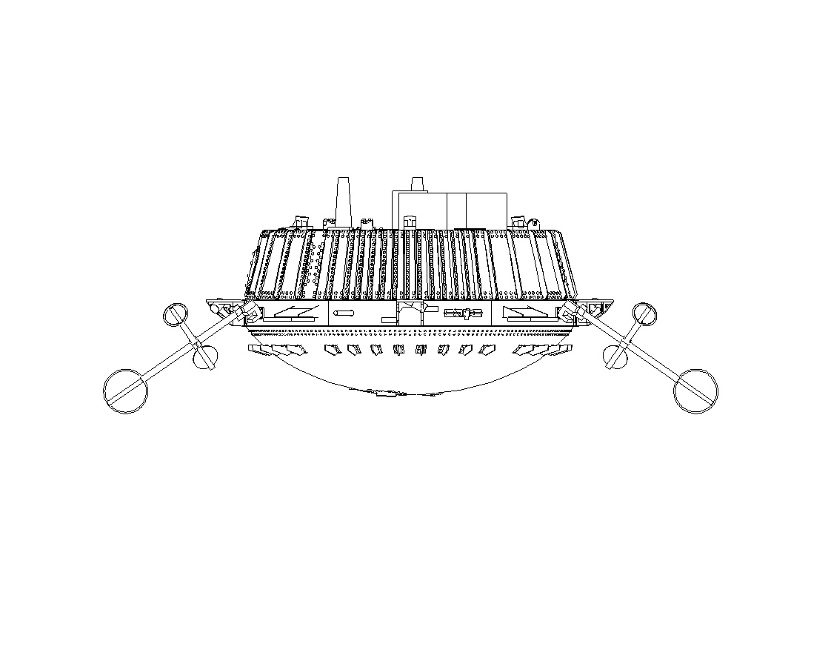
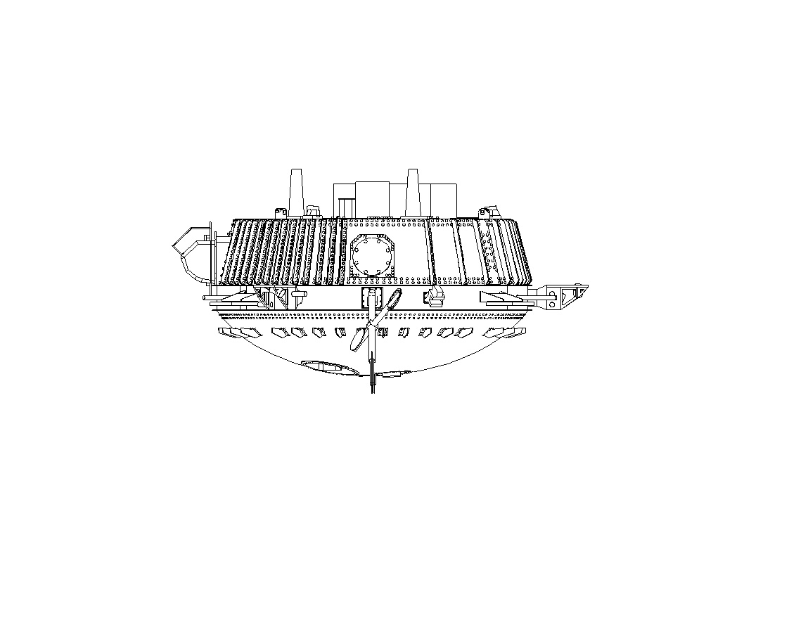
-Z
+Z
+Y
-Y
+Y
+Z
-Z
-Z
-Y
Original art work by Scott Brotherton for Space Cadet Models © 2015

Slide 37
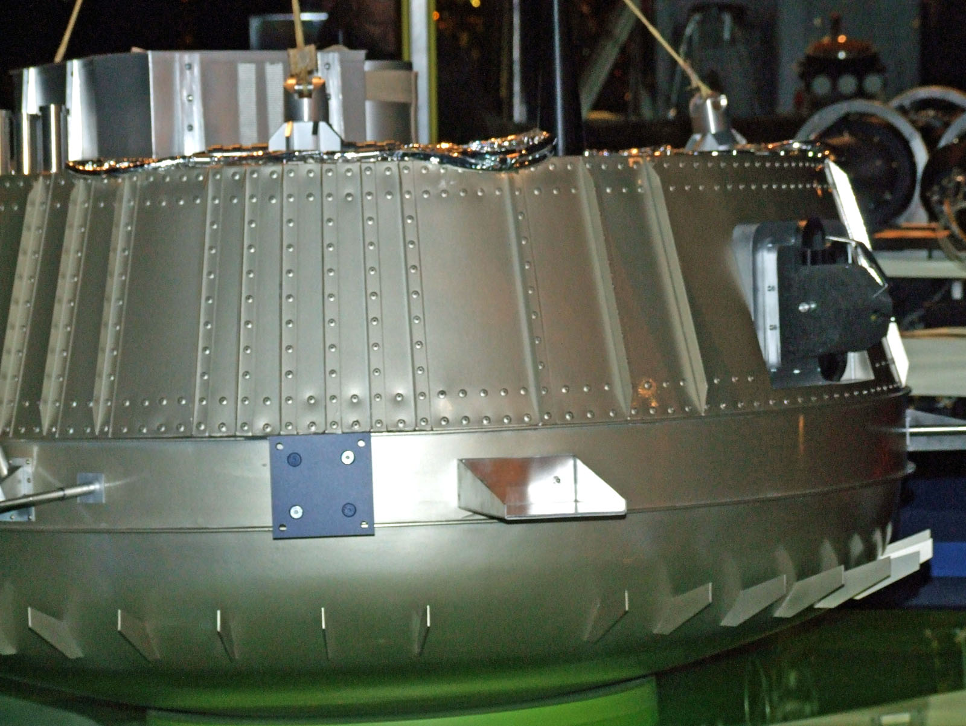
Rivets – we gots ‘em
More than 800 of them!

Slide 38
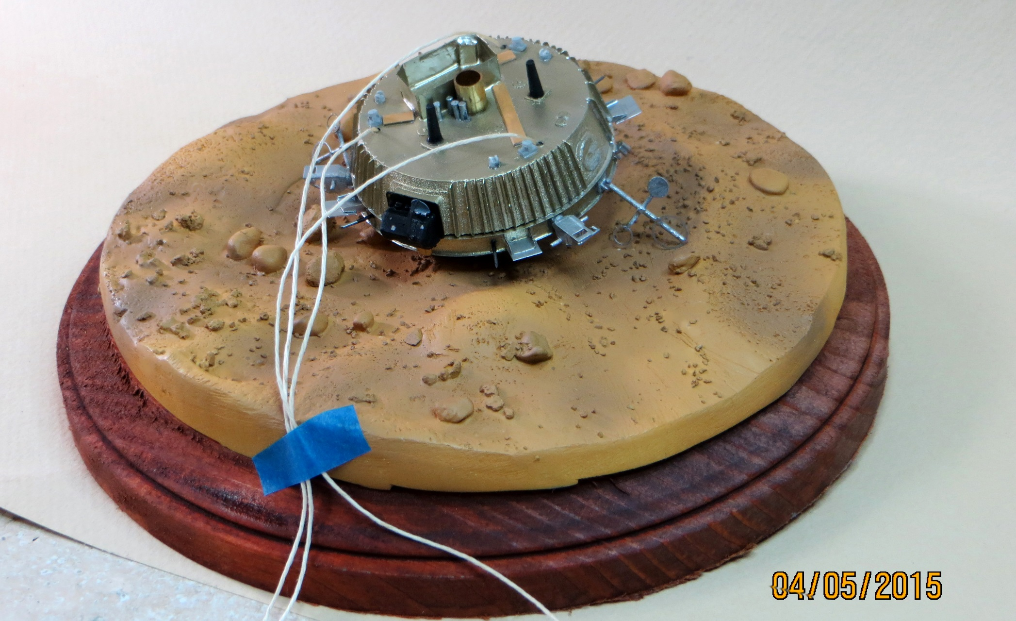
Test Shot of Huygens Model

Slide 39

THE END!
Our motto: “If we can’t
do it right, we won’t do it”
spacey57@comcast.net

