Slide 1


Slide 2






NASA built a small spaceship called

Slide 3
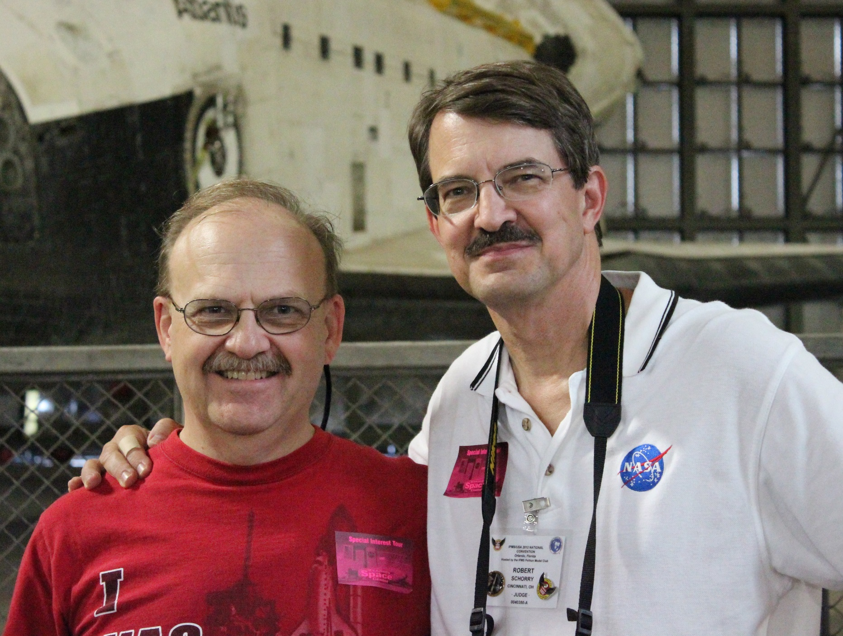
This got some people very excited!
Rob
Some other guy

Slide 4
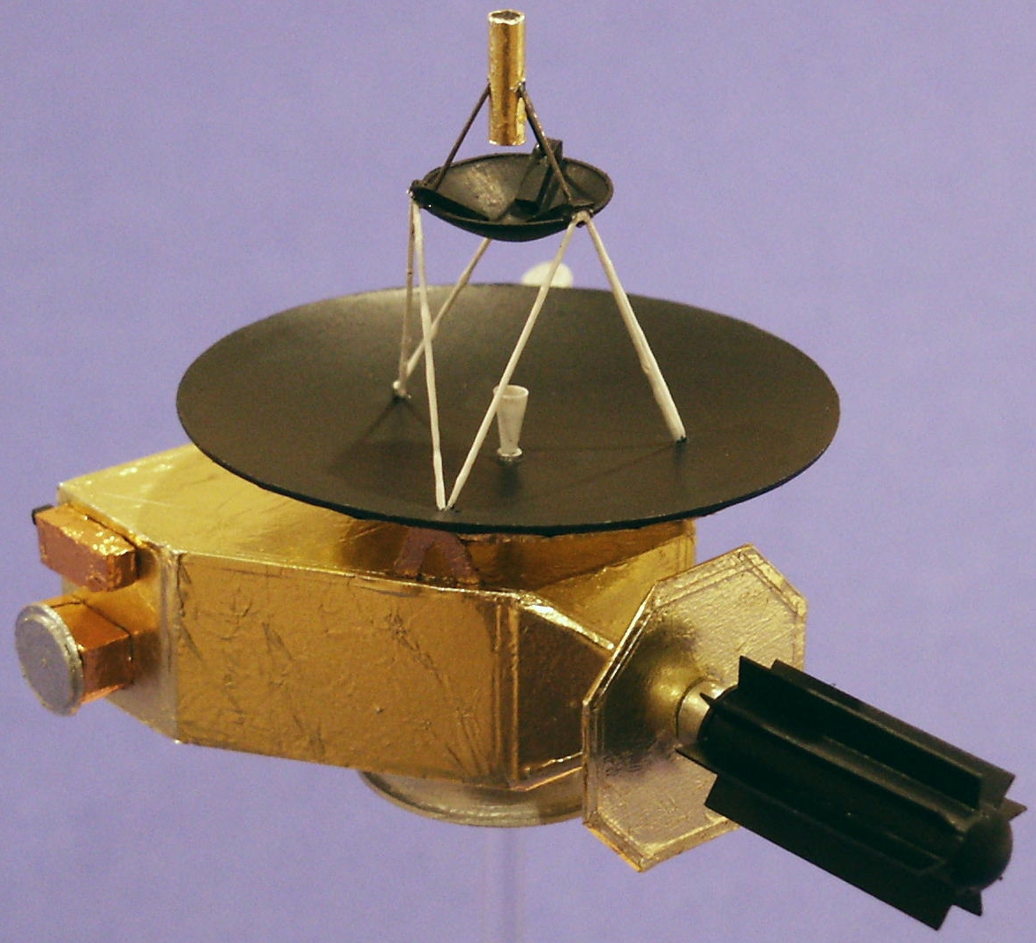
Based on the best info at the time, in 2003, he built a cool model…..

Slide 5
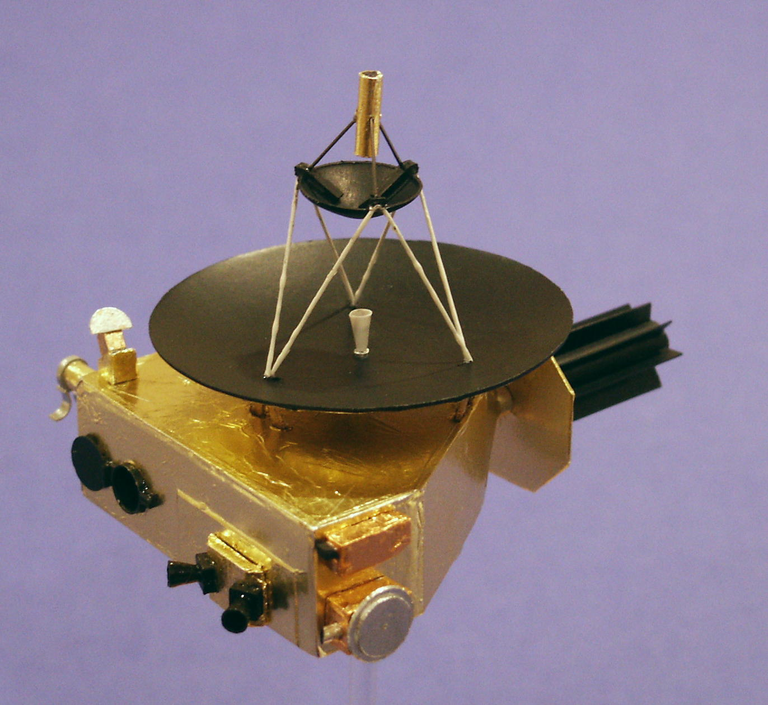
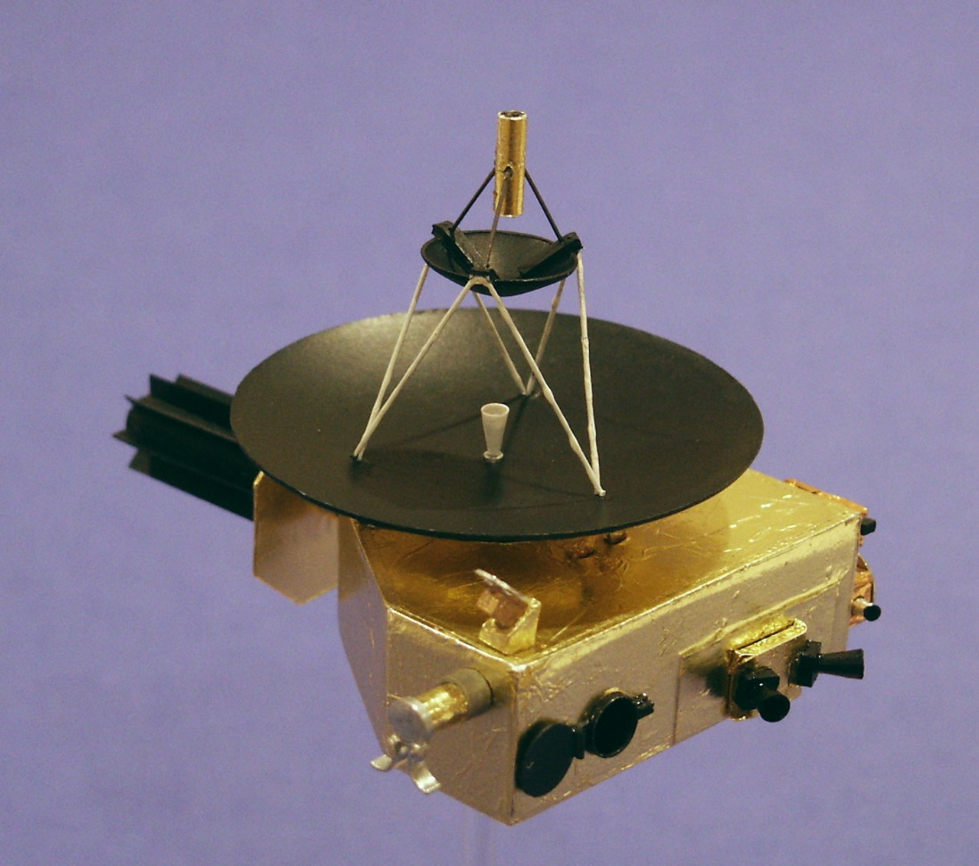
Big Attaboy, Rob!!

Slide 6
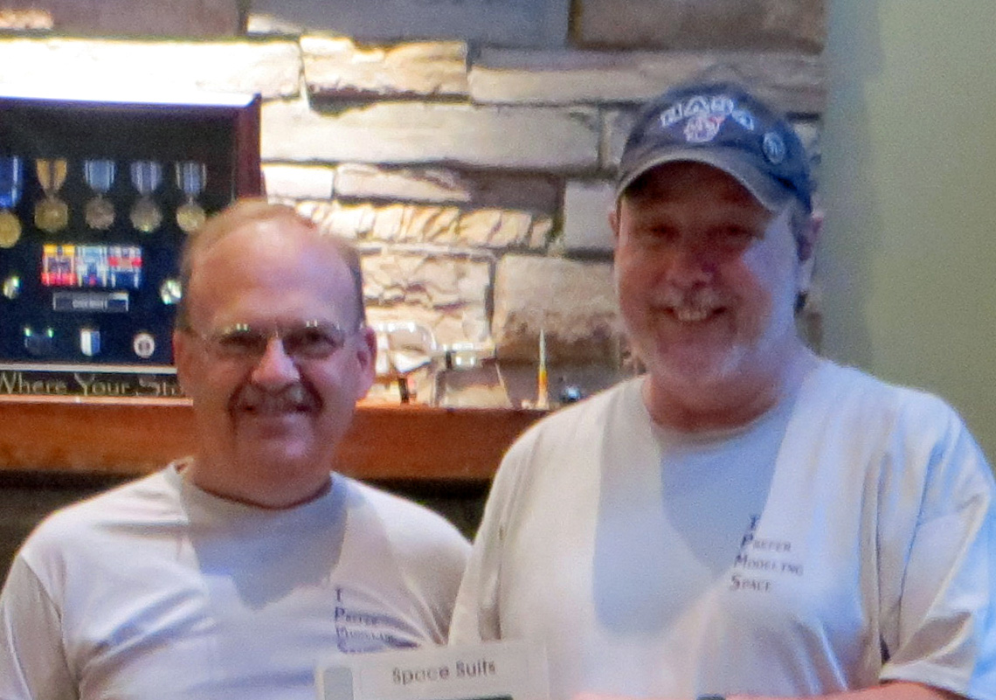
…which got someone else very excited….
Wow! I’m excited!!
Some other guy

Slide 7
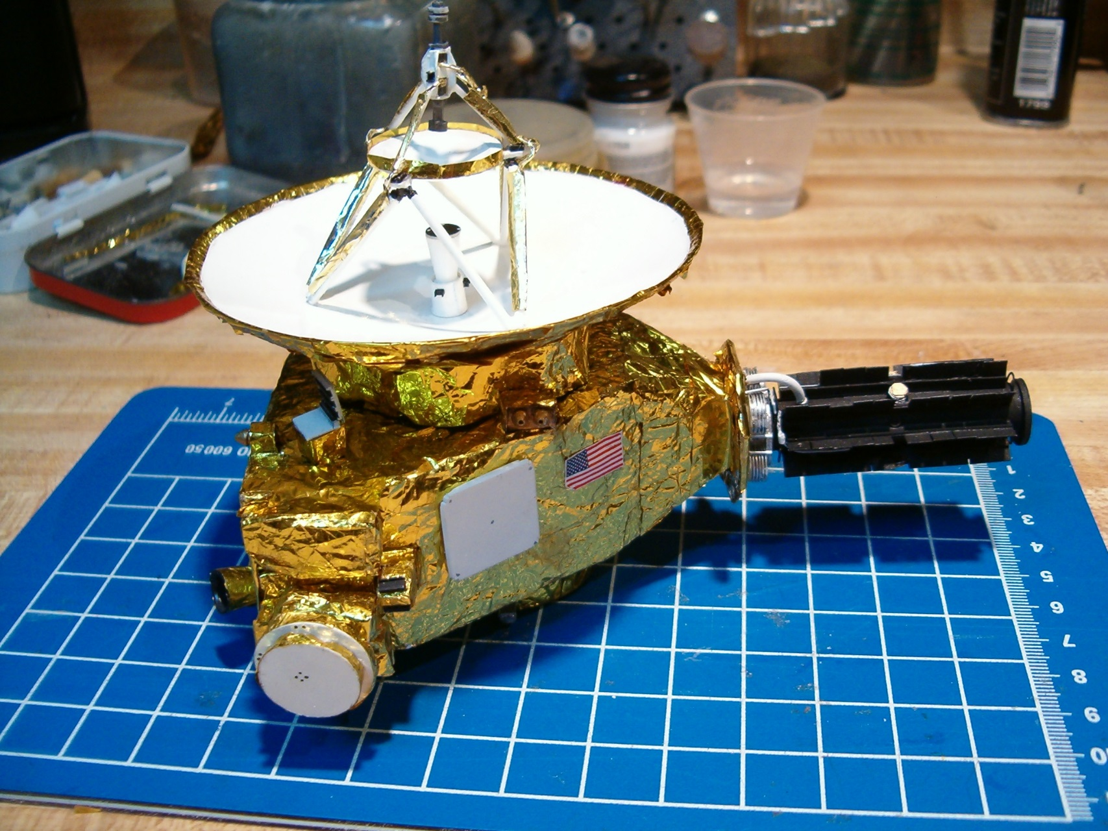
….and 2 years later….. built another model…..

Slide 8
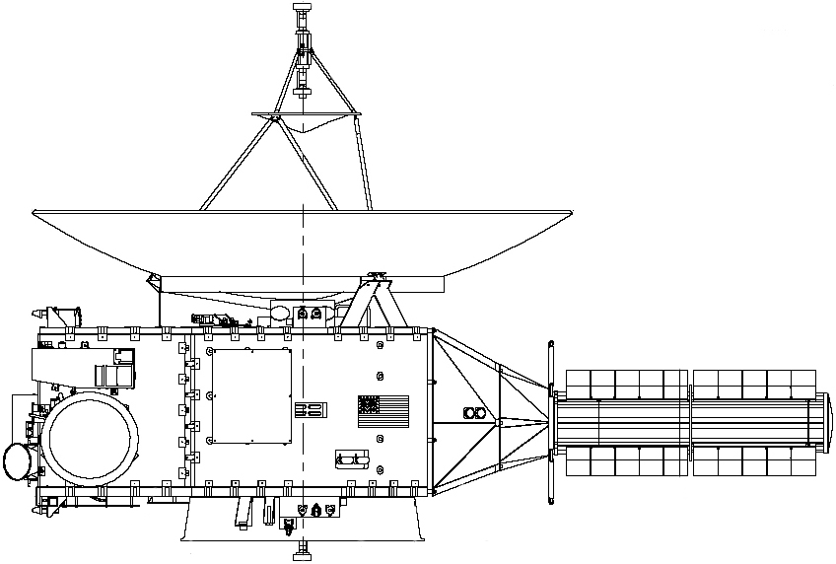
…with the benefit of these….

Slide 9
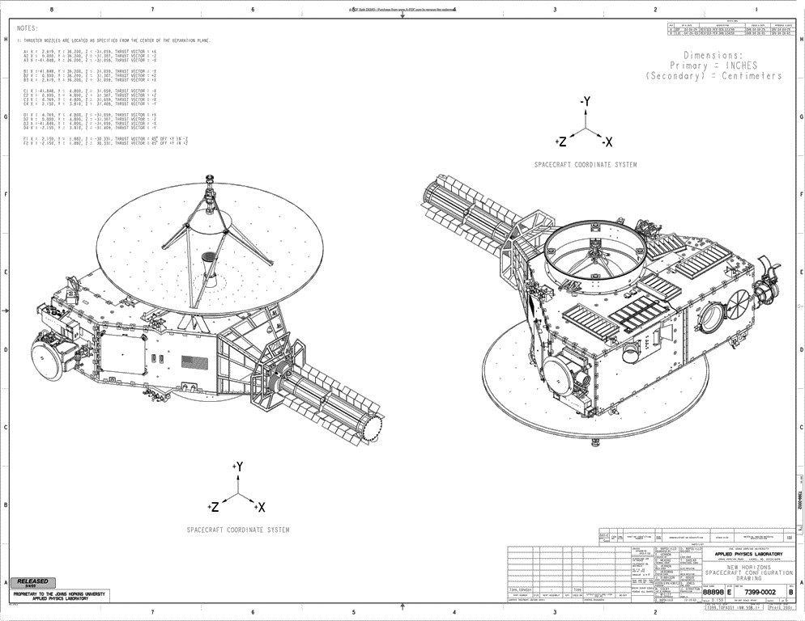

Slide 10
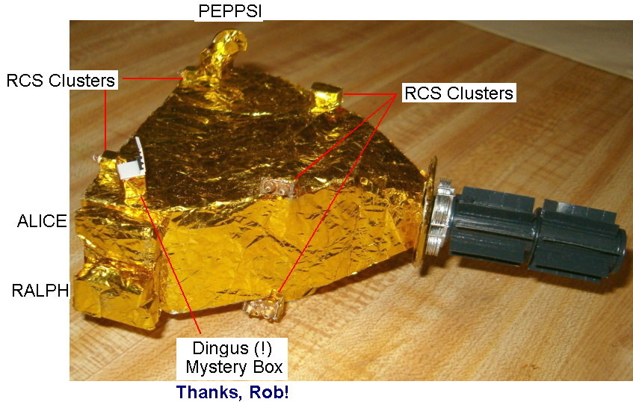

Slide 11
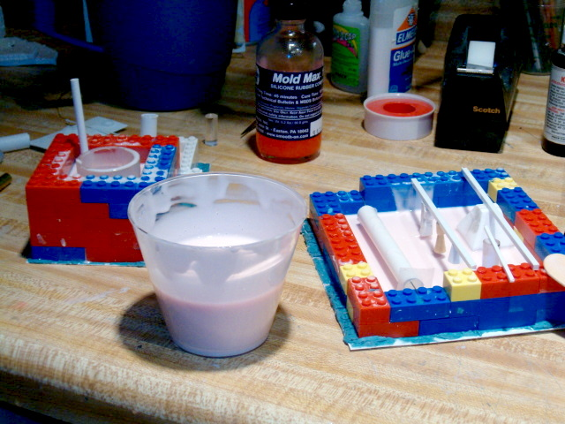
Originally intended as a kit… some mold making & castings…

Slide 12
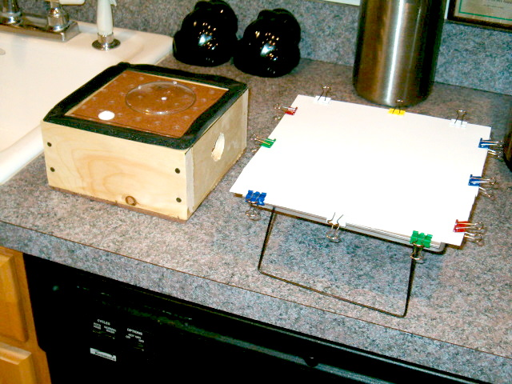
Vac-forming the HGA….

Slide 13
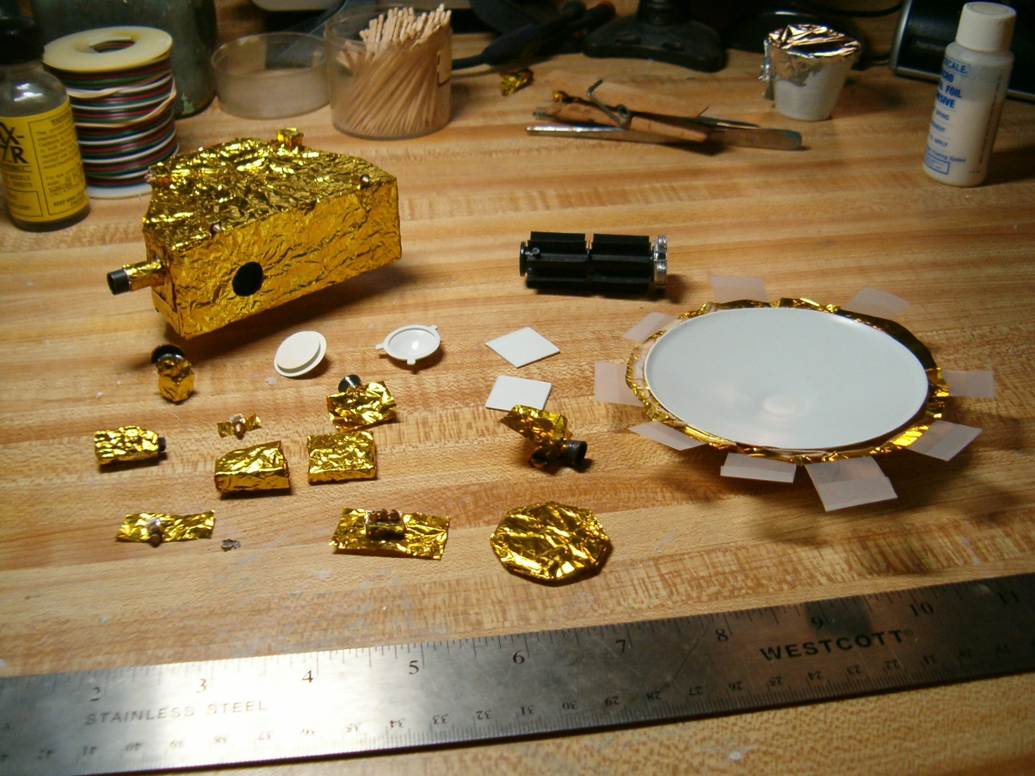
Foiling the parts

Slide 14
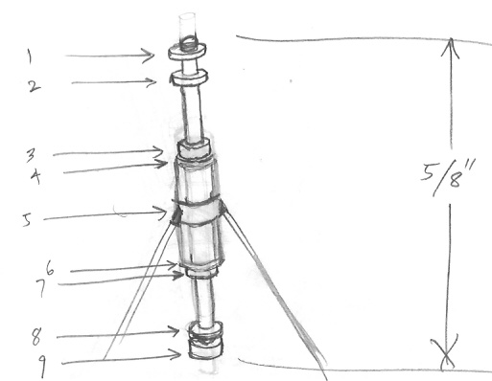
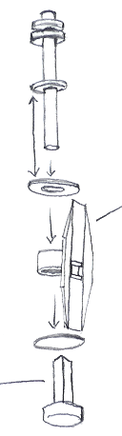
Original plans for the low/medium gain antenna

Slide 15
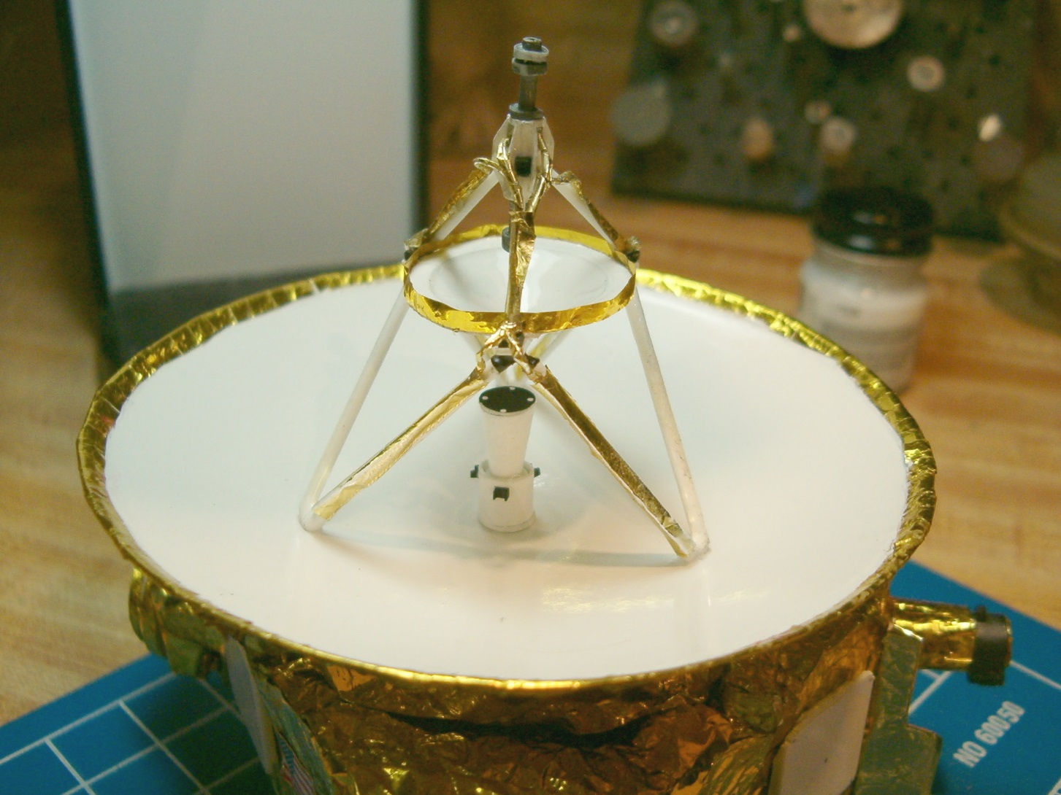

Slide 16
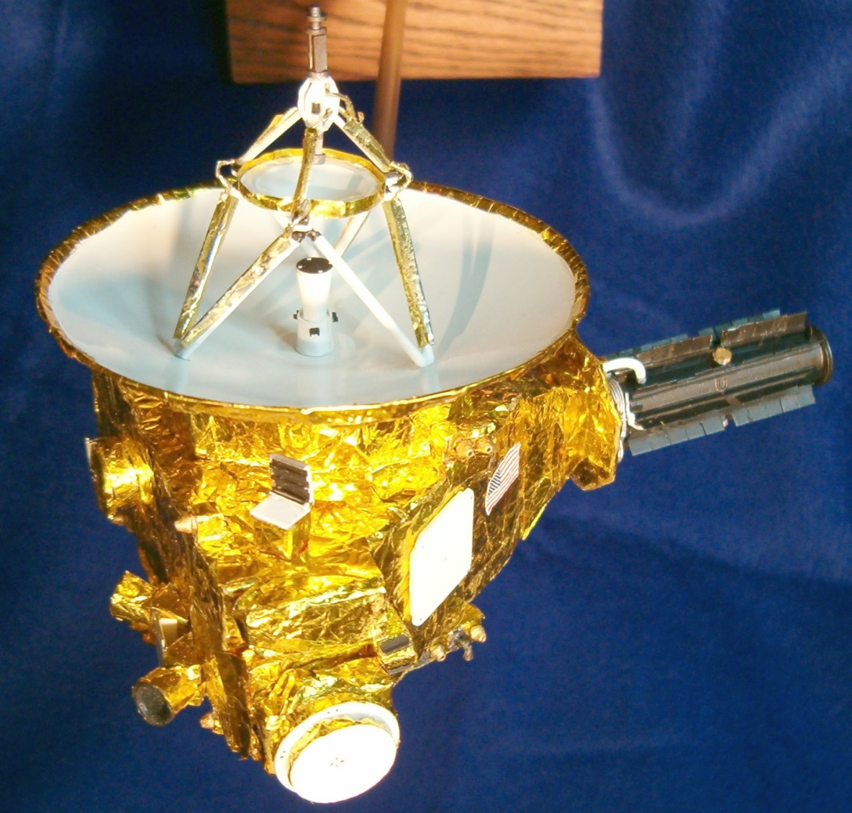
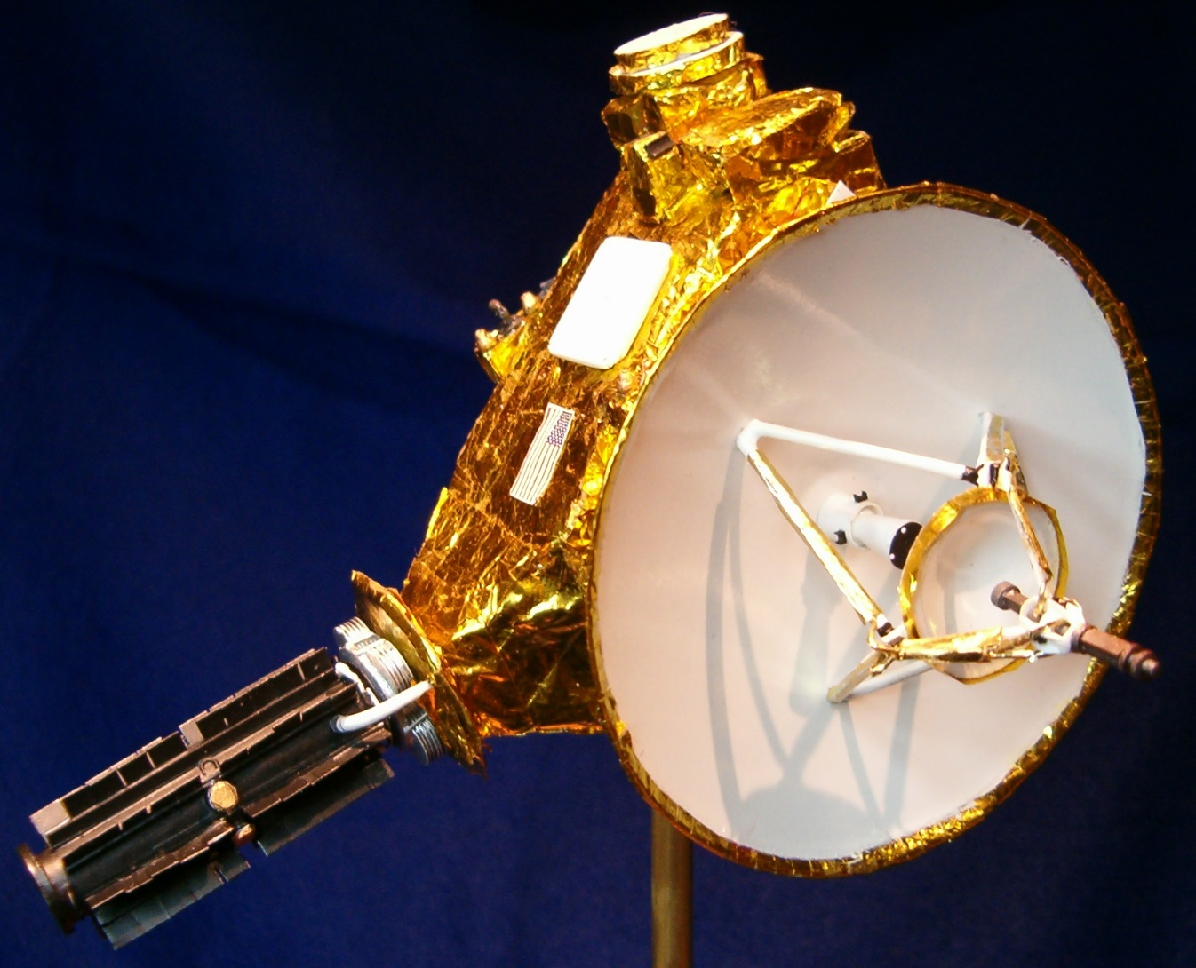
Done!

Slide 17
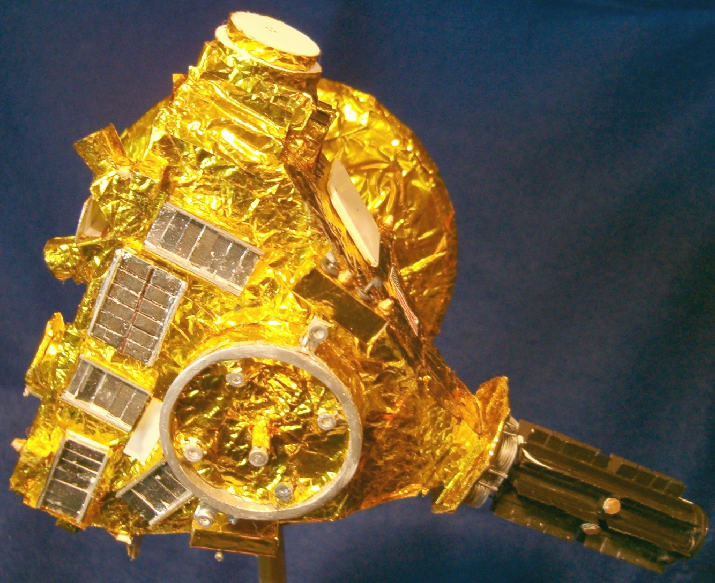

Slide 18
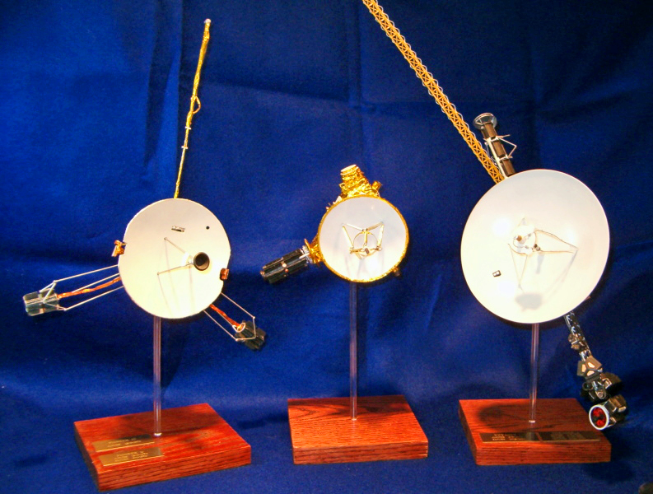
The Planetary Fleet

Slide 19
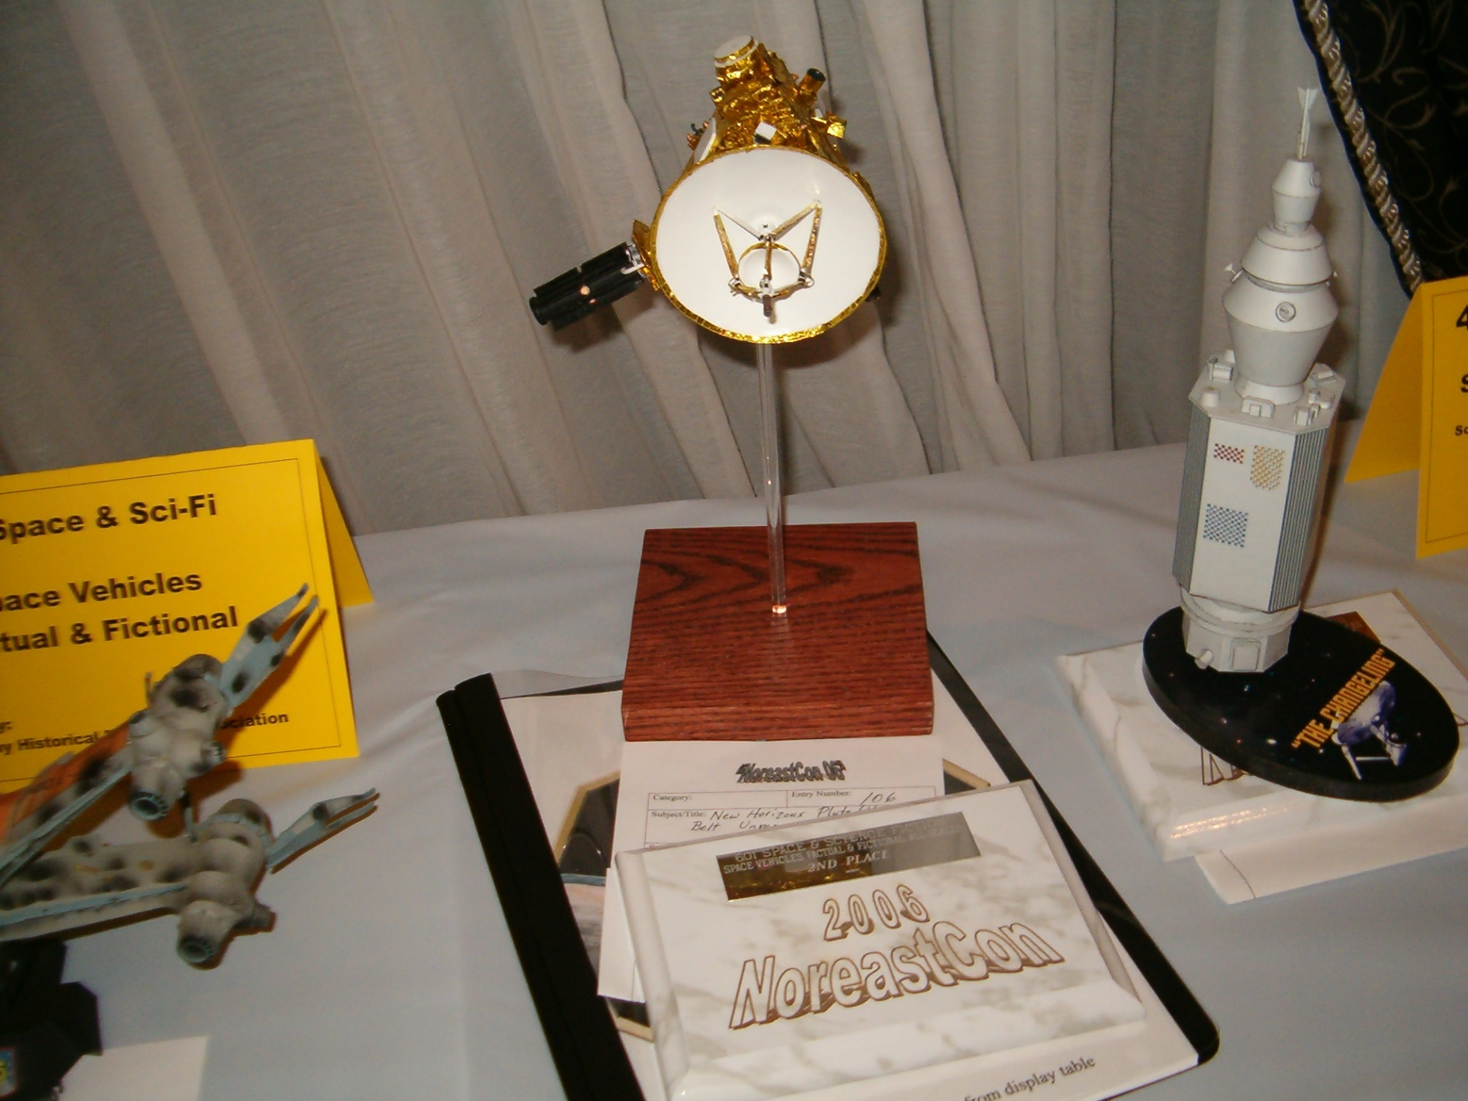
IPMS Noreastcon 2006

Slide 20
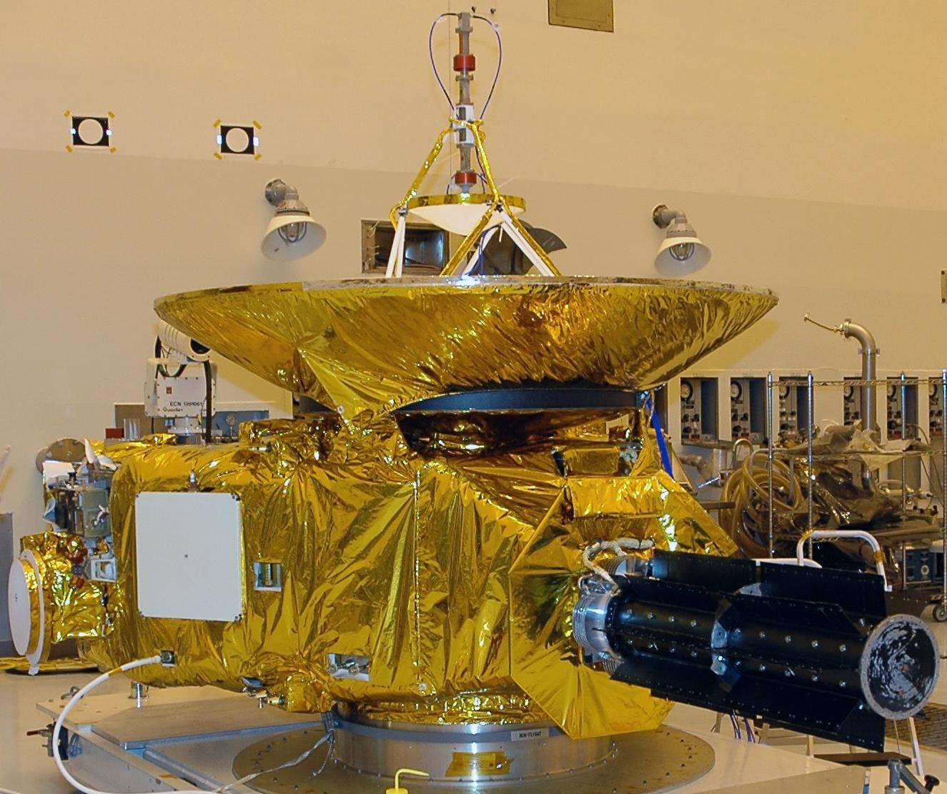
The Real McCoy

Slide 21
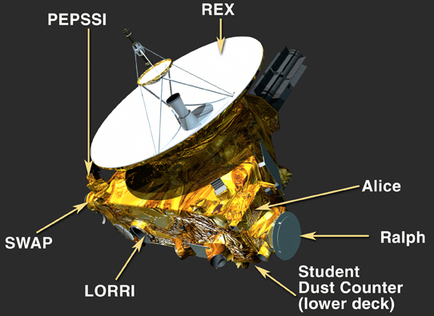
NH Instruments

Slide 22
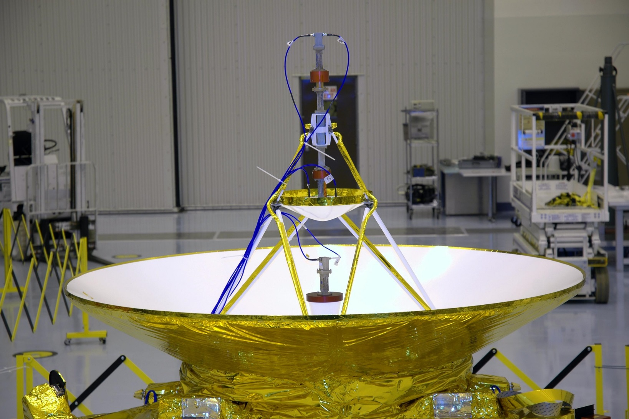

Slide 23
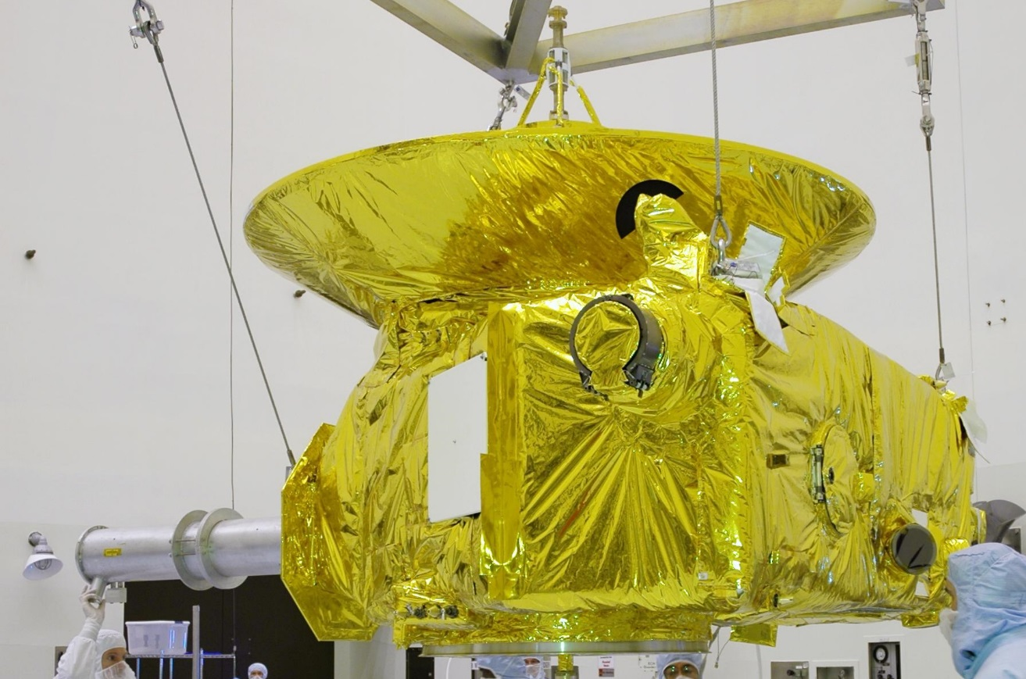

Slide 24
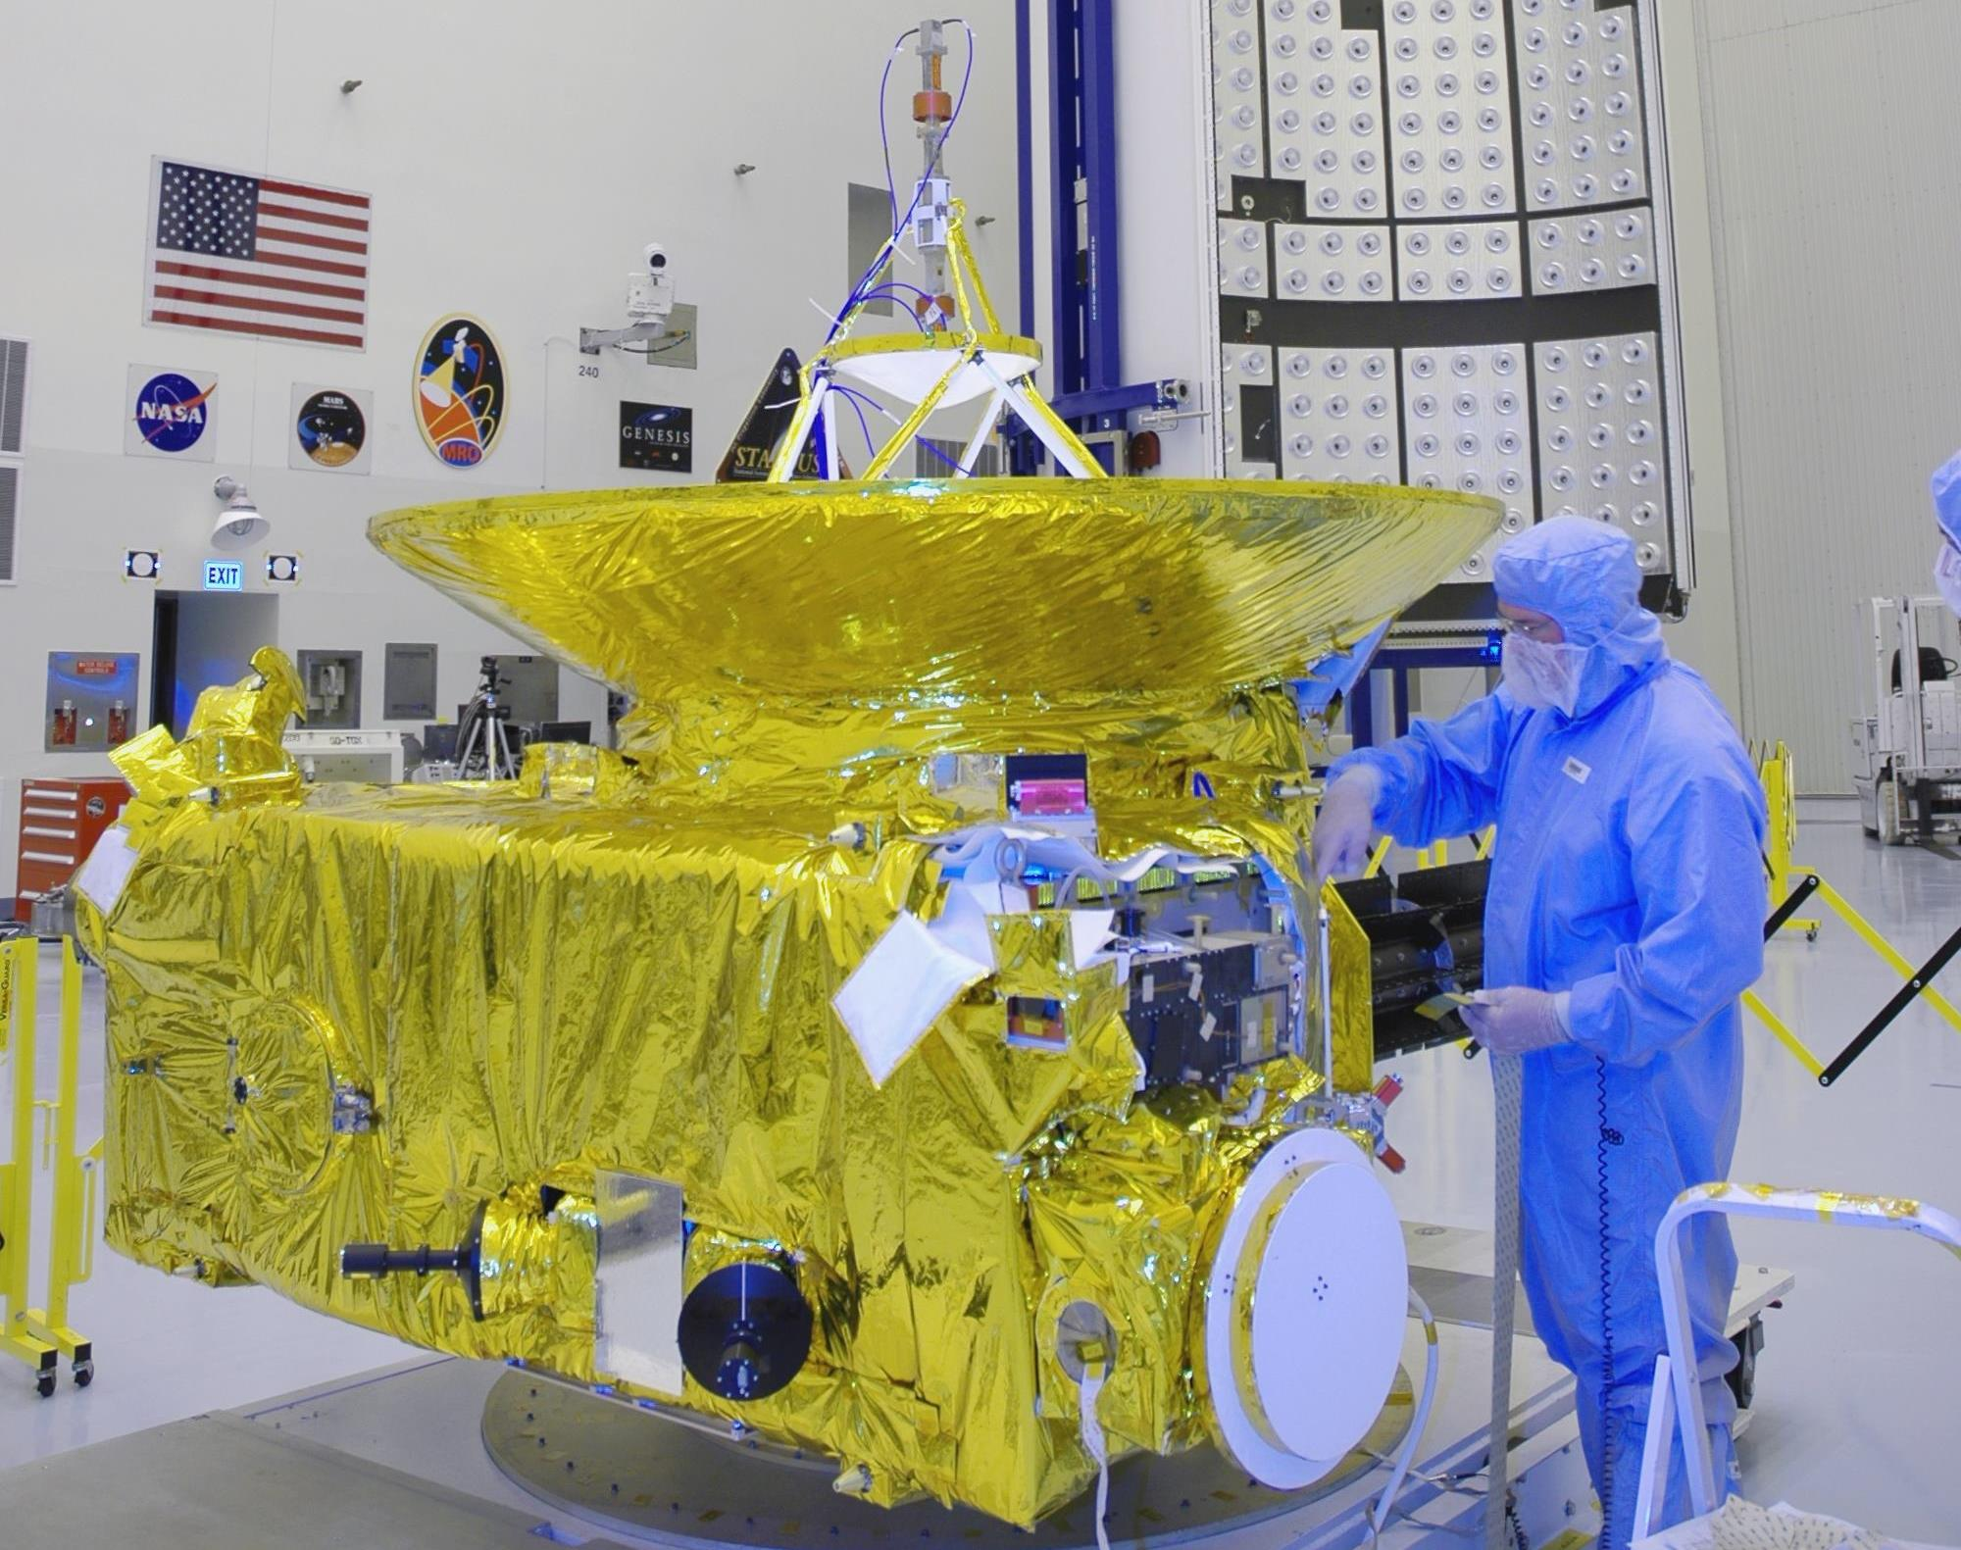

Slide 25
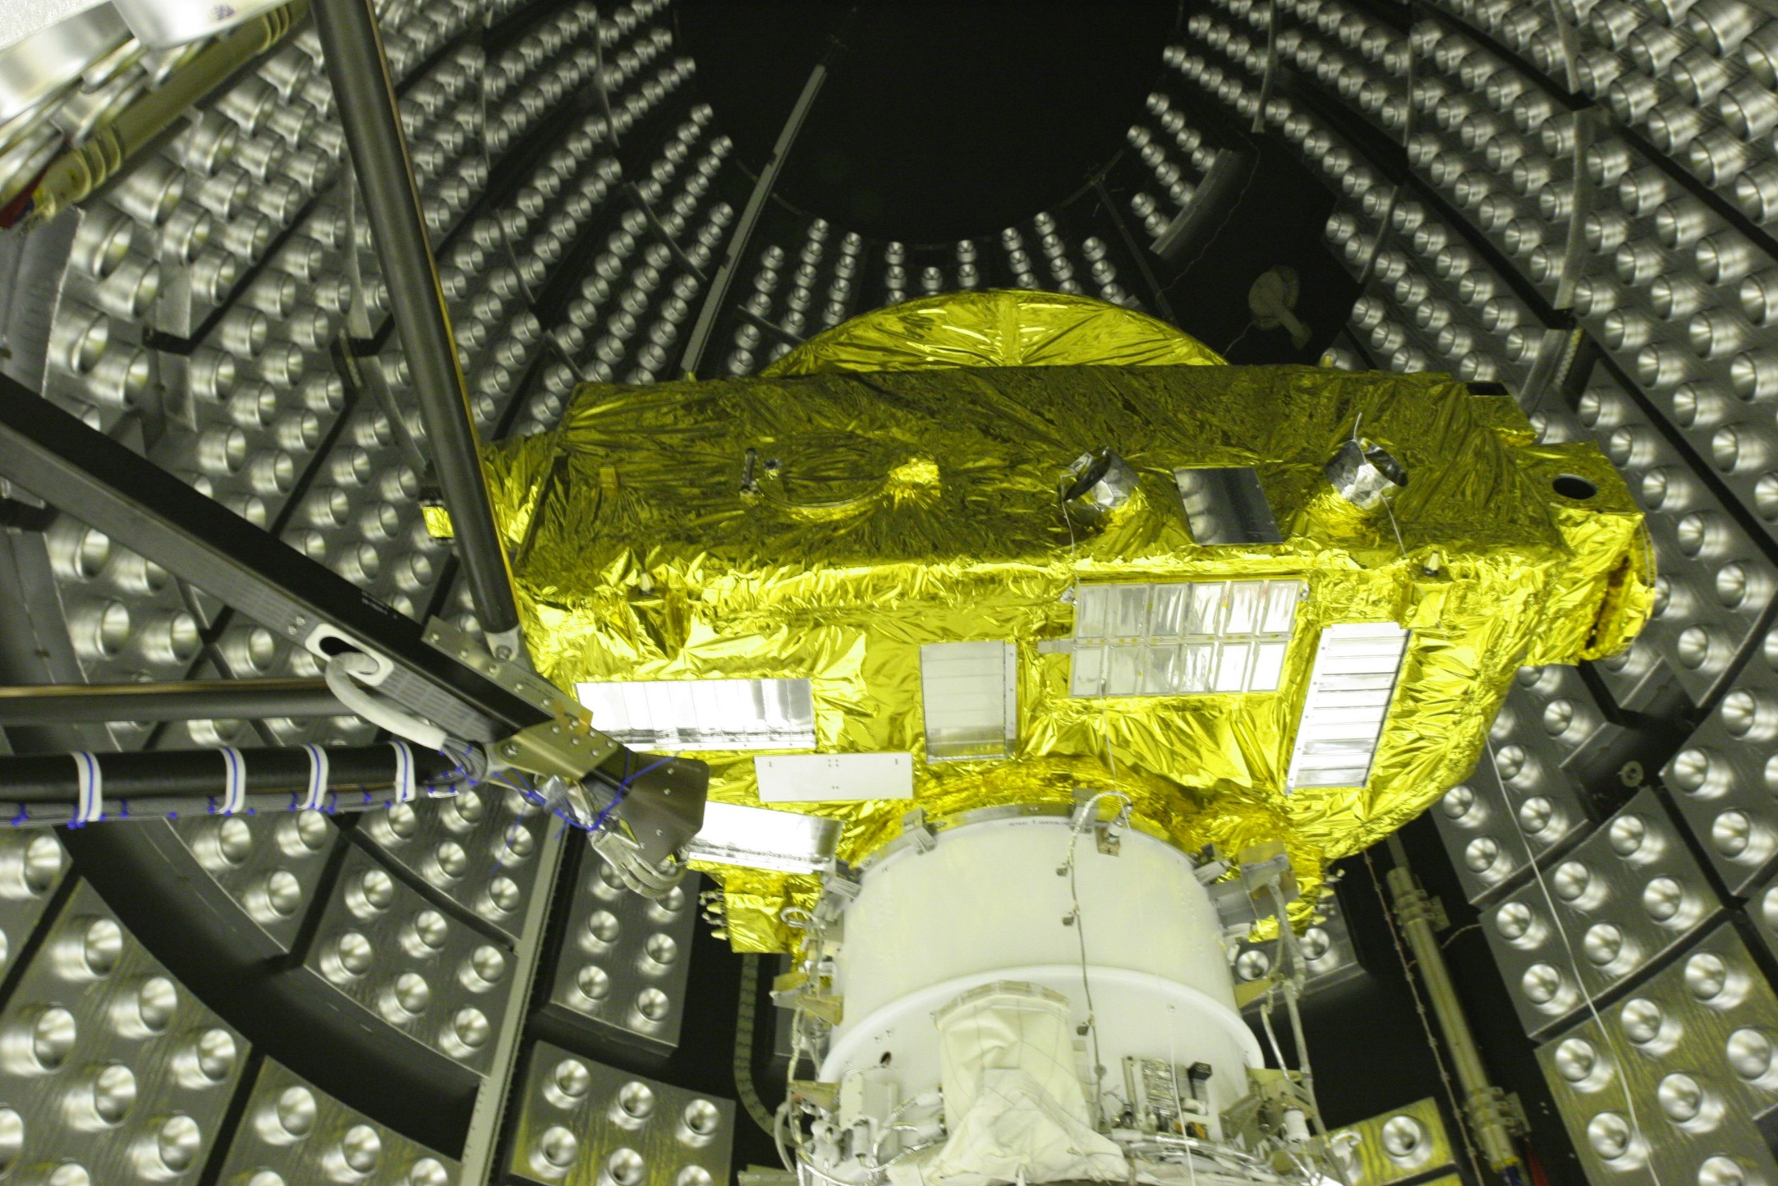

Slide 26
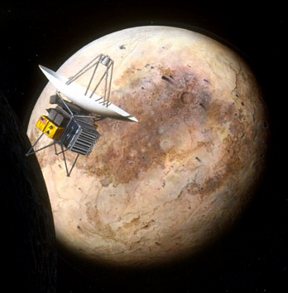
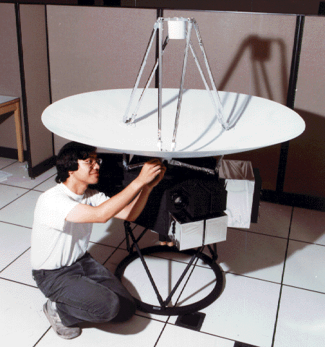
Early Concept: Pluto Fast Flyby
Yup – Rob built that, too!

Slide 27
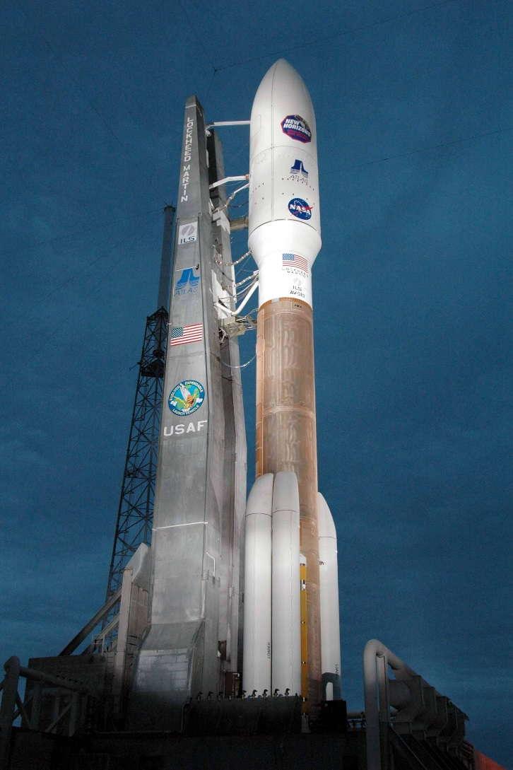
Launch vehicle
Launched from LC-41
on an Atlas V-500
vehicle AV-007
on January 19, 2006
New Horizons entered directly into an
Earth and Sun escape trajectory after
launch at a velocity of 58,536 km/h
(36,373 mph), making it the fastest spacecraft to ever leave Earth orbit,
100 times faster than a jetliner.

Slide 28
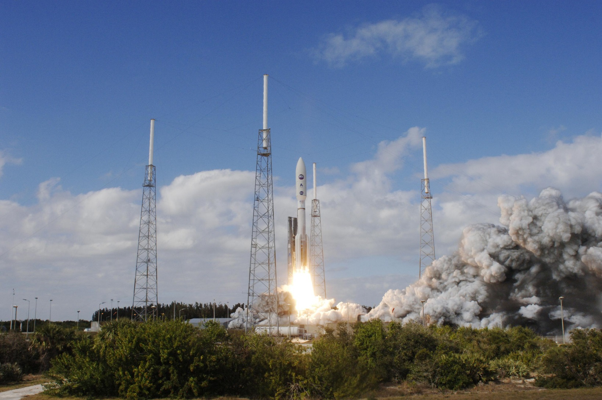

Slide 29
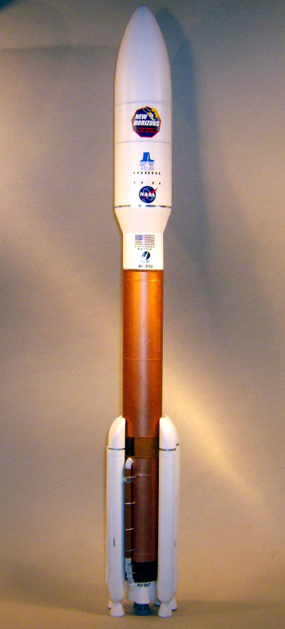
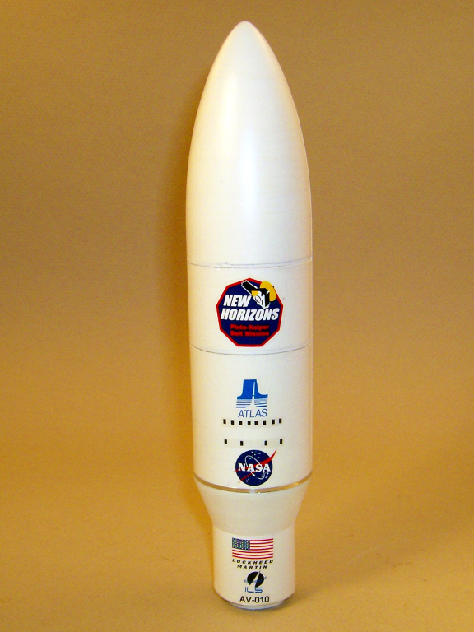
I built that, too….!
RealSpace Models Atlas V 1/144 scale

Slide 30
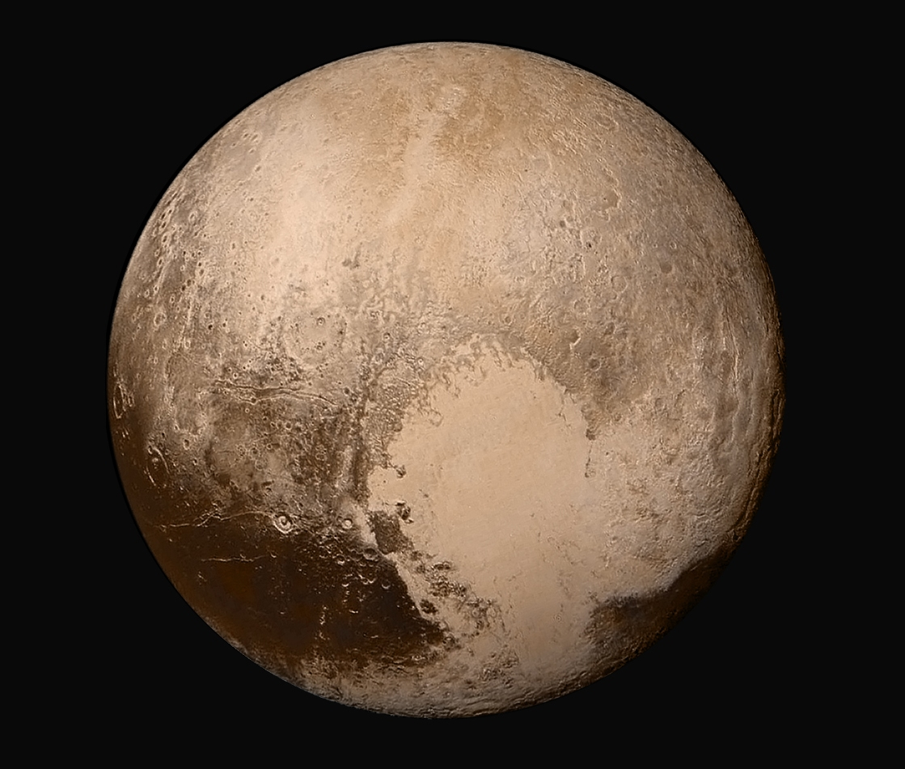

…..and, the rest is history….

Slide 31
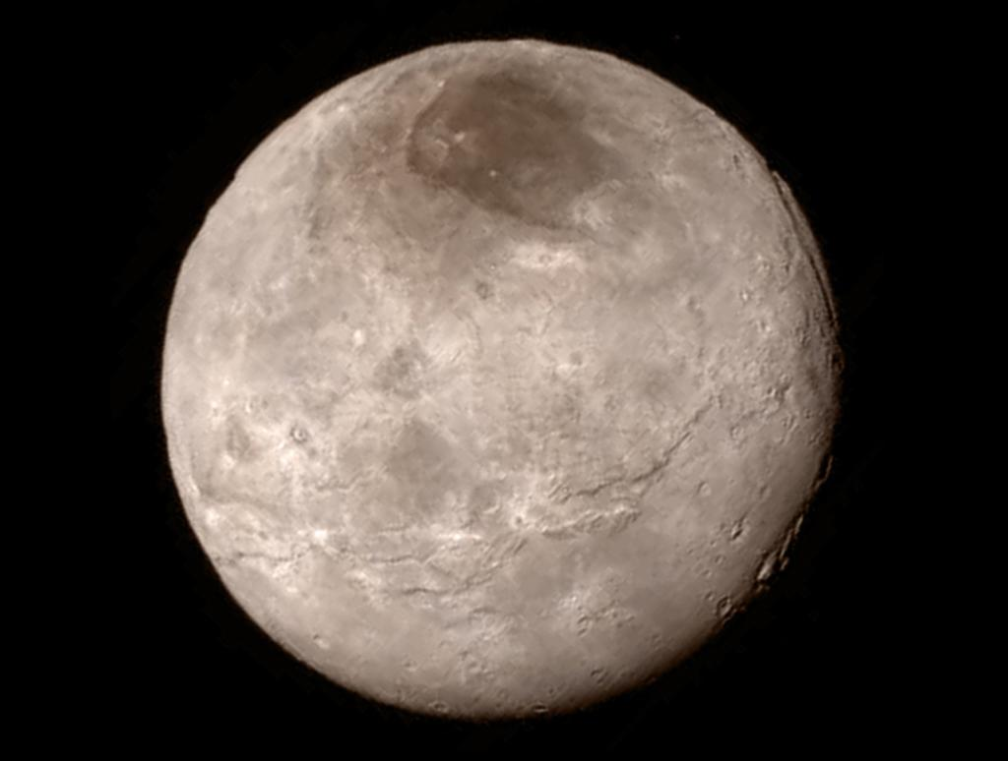
Charon

Slide 32
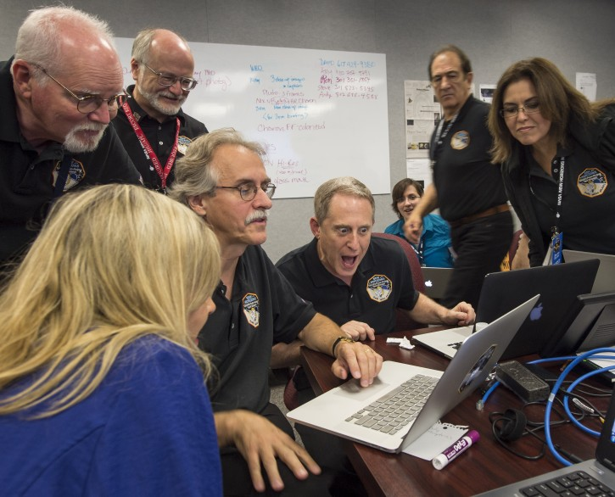
…which got some other folks very excited!
Dr. Alan Stern

Slide 33
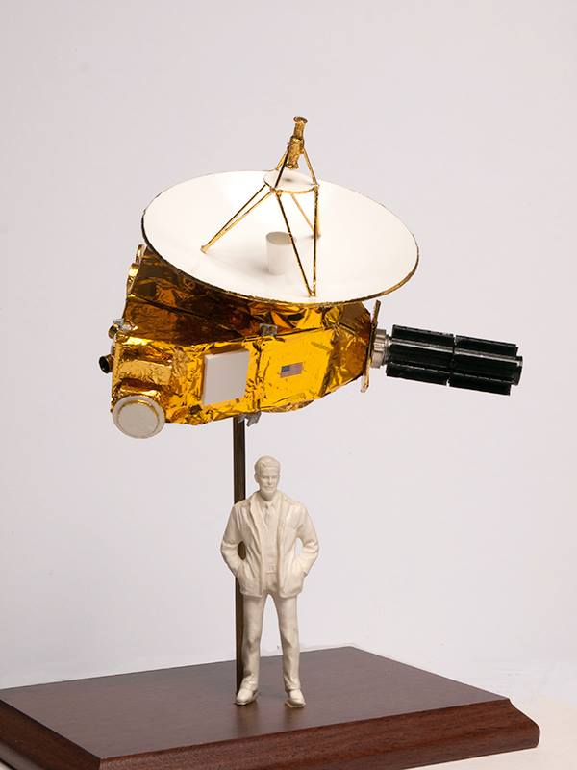

Photo courtesy Mr. Glenn Johnson
Used with permission

Slide 34
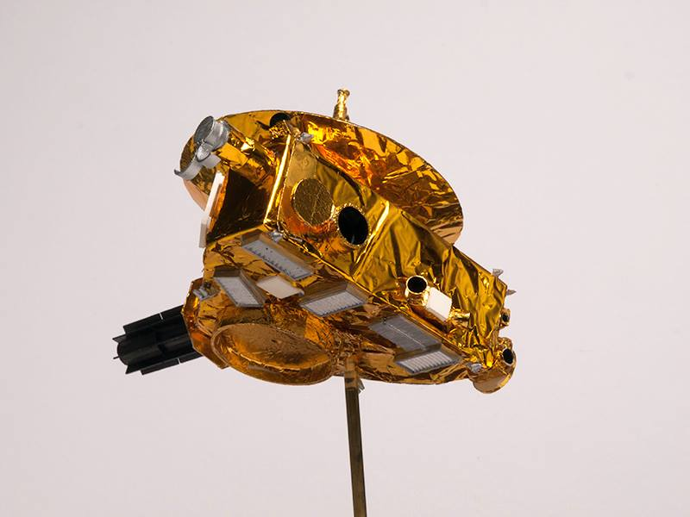
Photo courtesy Mr. Glenn Johnson
Used with permission

Slide 35

THE END!

Slide 36

Our motto: “If we can’t
do it right, we won’t do it”
spacey57@comcast.net

